Slide 1

MICROSOFT
POWER PLATFORM
with Copilot
COURSE SLIDES · WSQ
Create Intelligent Power Apps and Power Automate Workflows with Copilot
WSQ Course Code: TGS-2023036648
Conducted by Tertiary Infotech Academy Pte Ltd · UEN 201200696W
Version v12.0 · 2 September 2026
© 2026 Tertiary Infotech Academy Pte Ltd. All rights reserved. · www.tertiarycourses.com.sg

Slide 2
COURSE ADMINISTRATION
Welcome & Housekeeping
TGS-2023036648 · Power Apps & Power Automate with Copilot
© 2026 Tertiary Infotech Academy Pte Ltd
2

Slide 3
TRAQOM · SSG DIGITAL ATTENDANCE
Digital Attendance (Mandatory)
Three times a day
Take the AM, PM and Assessment digital attendance — mandatory for every WSQ-funded course.
Trainer shows the QR
The trainer or administrator displays the digital attendance QR code from the SSG portal.
1
2
Scan and submit
Scan the QR code with your mobile phone camera (or Singpass app) and submit your attendance.
75% minimum
A minimum of 75% attendance is required to be eligible for assessment and funding.
3
4
TGS-2023036648 · Power Apps & Power Automate with Copilot
© 2026 Tertiary Infotech Academy Pte Ltd
3

Slide 4
YOUR TRAINER · GENERAL
About the Trainer
NAME
____________________________________________
?
TITLE / DESIGNATION
____________________________________________
QUALIFICATIONS
____________________________________________
Your Trainer
AREAS OF EXPERTISE
____________________________________________
General Trainer template —
to be completed by the trainer
TRAINING & INDUSTRY EXPERIENCE
____________________________________________
CONTACT
____________________________________________
TGS-2023036648 · Power Apps & Power Automate with Copilot
© 2026 Tertiary Infotech Academy Pte Ltd
4

Slide 5
YOUR TRAINER
About the Trainer
ROLE
Principal Trainer, Tertiary Infotech Academy Pte Ltd
AA
CERTIFICATION
Microsoft Power Platform (PL-100 / PL-400), Azure and applied AI — 20+ years of training experience.
Dr. Alfred Ang
DELIVERS
WSQ courses on Power Platform, business automation, AI and data analytics.
Principal Trainer
Tertiary Infotech Academy Pte Ltd
FOUNDER
Founder and lead instructor at Tertiary Infotech / Tertiary Courses.
TGS-2023036648 · Power Apps & Power Automate with Copilot
© 2026 Tertiary Infotech Academy Pte Ltd
5

Slide 6
ICE-BREAKER
Let's Know Each Other
Who you are
Your name, organisation and role.
Your starting point
Your experience with Power Apps, Power Automate, Excel or any low-code tool.
1
2
The process you'd automate
One business process in your organisation you would most like to automate.
What you want to leave with
What you want to walk out of this 4-day course able to build.
3
4
TGS-2023036648 · Power Apps & Power Automate with Copilot
© 2026 Tertiary Infotech Academy Pte Ltd
6

Slide 7
HOUSEKEEPING
Ground Rules
Set your mobile phone to silent mode.
Participate actively — no question is too small.
1
2
Respect each other's views; agree to disagree.
One conversation at a time.
3
4
Exit quietly for a call or a break, and return on time.
75% attendance is required for funding.
5
6
TGS-2023036648 · Power Apps & Power Automate with Copilot
© 2026 Tertiary Infotech Academy Pte Ltd
7

Slide 8

COURSE PORTAL
Login to LMS and Download Course Material
Log in at lms-tms.tertiaryinfotech.com with your registered email and the OTP sent to your inbox, then open this course to download the slides and Learner Guide.
TGS-2023036648 · Power Apps & Power Automate with Copilot
© 2026 Tertiary Infotech Academy Pte Ltd
8

Slide 9
LMS / TMS · lms-tms.tertiaryinfotech.com
Download Your Course Material
1 · Go to the LMS portal
Open https://lms-tms.tertiaryinfotech.com in your browser.
2 · Log in
Sign in with the account e-mail you used to register for this course.
1
2
3 · Open this course
Select 'Create Intelligent Power Apps and Power Automate Workflows with Copilot'.
4 · Download
Download the Trainer Slides, Learner Guide and Lesson Plan (PDF).
3
4
5 · Get the labs
Open the labs folder — 26 labs, each with its own step-by-step guide and mock data.
6 · Keep them open
You may use these materials during the open-book assessment.
5
6
TGS-2023036648 · Power Apps & Power Automate with Copilot
© 2026 Tertiary Infotech Academy Pte Ltd
9

Slide 10
COURSE ENVIRONMENT
Your Training Environment
Microsoft 365 account
The trainer assigns you a training account — use the same login for every lab.
One environment
Stay in the environment the trainer names (e.g. Dev One). Flows, apps and agents must share it.
1
2
Power Apps
make.powerapps.com — canvas apps, model-driven apps, Dataverse tables.
Power Automate
make.powerautomate.com — cloud flows, approvals, run history.
3
4
Copilot Studio
copilotstudio.microsoft.com — agents, agent flows, knowledge and tools.
Do not change passwords
These are shared training accounts. Leave the credentials as issued.
5
6
TGS-2023036648 · Power Apps & Power Automate with Copilot
© 2026 Tertiary Infotech Academy Pte Ltd
10

Slide 11
SKILLS FRAMEWORK · TSC
Skills Framework Alignment
TSC Title
Applications Integration
TSC Code
ICT-DIT-3003-1.1
1
2
A1 / A2
Identify integration opportunities across devices, databases and applications; perform feasibility scans.
A3 / A4
Utilise middleware to integrate data and functions across programs; support API-level integration.
3
4
A5 / A6
Perform tests and checks on connections; verify modules function across integrated platforms.
A7 / A8
Highlight technical, compatibility and performance issues; implement modifications to middleware.
5
6
TGS-2023036648 · Power Apps & Power Automate with Copilot
© 2026 Tertiary Infotech Academy Pte Ltd
11

Slide 12
WHAT YOU'LL ACHIEVE
Learning Outcomes
LO1 · Identify & scan
Identify opportunities for creating connections in Microsoft Power Platform and perform feasibility scans.
LO2 · Integrate with Power Apps
Utilise Power Apps to integrate data and functions across programs and API-level integration.
1
2
LO3 · Test with Power Automate
Execute tests in Power Automate to verify connections between disparate programs across platforms.
LO4 · Resolve & modify
Resolve technical issues in Power Platform and implement modifications to Power Platform middleware.
3
4
TGS-2023036648 · Power Apps & Power Automate with Copilot
© 2026 Tertiary Infotech Academy Pte Ltd
12

Slide 13
19 TOPICS · 26 HANDS-ON LABS
Course Outline — Four Learning Units
1
LU1 — Get Started with Copilot for Power Platform
Topics 1–4 · Copilot in Power Apps, Power Automate and Power Pages · Labs 1–4.
2
LU2 — Create and Manage Canvas Apps
Topics 5–10 · data, formulas, UI, external data, forms, publishing, PCF · Labs 5–12.
3
LU3 — Automated Processes with Power Automate & Copilot Studio Agents
Topics 11–14 · flows, approvals, filters, agents, tools, structured output · Labs 13–20.
4
LU4 — Model-Driven Apps with Power Apps and Dataverse
Topics 15–19 · tables, forms, views, charts, solutions, troubleshooting · Labs 21–26.
TGS-2023036648 · Power Apps & Power Automate with Copilot
© 2026 Tertiary Infotech Academy Pte Ltd
13

Slide 14
SCHEDULE · 9:30am – 6:30pm
Lesson Plan — Days 1 & 2
Day 1
Day 2
• Day 1 — Copilot for Power Platform & First Canvas Apps
– Digital Attendance (AM) · Introductions · Learning Outcomes
– LU1 Topics 1–4: Copilot across Power Platform
– Labs 1–4: environment scan, Copilot app, Copilot flow, Power Pages
– Lunch Break · Digital Attendance (PM)
– LU2 Topics 5–6: canvas apps and the Dataverse data model
– Labs 5–7: Excel app, Dataverse tables, canvas app over Dataverse
• Day 2 — Canvas Apps: UI, External Data, Forms & Publishing
– Digital Attendance (AM) · Day 1 recap
– LU2 Topics 7–8: building the UI and working with external data
– Labs 8–9: theming and branding, SharePoint + collections + Patch
– Lunch Break · Digital Attendance (PM)
– LU2 Topics 9–10: writing data with forms, publish and maintain
– Labs 10–12: forms, PCF code component, publish and share
TGS-2023036648 · Power Apps & Power Automate with Copilot
© 2026 Tertiary Infotech Academy Pte Ltd
14

Slide 15
SCHEDULE · 9:30am – 6:30pm
Lesson Plan — Days 3 & 4
Day 3
Day 4
• Day 3 — Power Automate Flows & Copilot Studio Agents
– Digital Attendance (AM) · Day 2 recap
– LU3 Topics 11–12: flow anatomy, triggers, actions, approvals
– Labs 13–15: three ways to build a flow, approvals, button & scheduled
– Lunch Break · Digital Attendance (PM)
– LU3 Topics 13–14: trigger filters, Copilot Studio agents
– Labs 16–20: filters, agents, tools, structured output, multi-agent
• Day 4 — Model-Driven Apps, Dataverse, Solutions & Assessment
– Digital Attendance (AM) · Day 3 recap
– LU4 Topics 15–17: Dataverse tables, model-driven apps, forms & views
– Labs 21–24: tables, model-driven app, forms/views, charts
– Lunch Break · Digital Attendance (PM)
– LU4 Topics 18–19: solutions, ALM and troubleshooting · Labs 25–26
– Briefing · Digital Attendance (Assessment) · WA + PP · TRAQOM
TGS-2023036648 · Power Apps & Power Automate with Copilot
© 2026 Tertiary Infotech Academy Pte Ltd
15

Slide 16
1
LU1
Get Started with Copilot for Microsoft Power Platform
Topics 1–4 · Labs 1–4
TGS-2023036648 · Power Apps & Power Automate with Copilot
© 2026 Tertiary Infotech Academy Pte Ltd
16

Slide 17
CORE CONCEPTS
The Power Platform, and What Copilot Changes
TGS-2023036648 · Power Apps & Power Automate with Copilot
© 2026 Tertiary Infotech Academy Pte Ltd
17

Slide 18
CORE CONCEPT
What Business Process Automation Removes
1
2
3
4
Form filled in
Someone reads it
Re-typed into Excel
Someone remembers
a person types it
and re-keys the data
the second copy
to reply — or forgets
THE HAND-OFF IS THE COST
Automation is not software doing the same work faster. It removes the hand-off where a person re-types what another system already knows.
TGS-2023036648 · Power Apps & Power Automate with Copilot
© 2026 Tertiary Infotech Academy Pte Ltd
18

Slide 19
CORE CONCEPT · THE PLATFORM
The Power Platform — Four Products, One Environment
Power Apps
Canvas and model-driven applications over your data. Labs 2, 5–12, 21–24.
Power Automate
Cloud flows: triggers and actions that run without a person. Labs 3, 13–16.
1
2
Copilot Studio
Conversational agents with instructions, knowledge and tools. Labs 17–20.
Power Pages
External-facing websites backed by Dataverse. Lab 4.
3
4
Dataverse
The managed data store behind the environment. Labs 6, 21, 25.
Connectors
Excel, SharePoint, Outlook, Teams, SQL, HTTP — 1,000+ integration points.
5
6
TGS-2023036648 · Power Apps & Power Automate with Copilot
© 2026 Tertiary Infotech Academy Pte Ltd
19

Slide 20
CORE CONCEPT · ENVIRONMENTS
The environment is the container.
Apps, flows, agents and data all live inside ONE environment. If Power Automate and Copilot Studio point at different environments, your agent cannot see your flow. This is the single most common "where did it go?" in this course.
TGS-2023036648 · Power Apps & Power Automate with Copilot
© 2026 Tertiary Infotech Academy Pte Ltd
20

Slide 21
CORE CONCEPT · THE CASE FOR AUTOMATION
Where the Manual Hours Actually Go
WHAT THE DATA SHOWS
Re-keying and chasing approvals — the two hand-offs a flow removes outright — account for more than half the manual hours. These map directly to Labs 13–16.
TGS-2023036648 · Power Apps & Power Automate with Copilot
© 2026 Tertiary Infotech Academy Pte Ltd
21

Slide 22
TOPIC 1 · INTRODUCTION TO COPILOT
A Copilot Is an AI Assistant You Reach Through Chat
Generic copilot
Microsoft Copilot — not tied to any one product.
Context-aware copilot
Tailored to the product you are in right now.
1
2
Maker-facing
Helps you BUILD the app, flow or site — Labs 2, 3, 4.
User-facing
Helps the END USER ask questions of the app's data.
3
4
TGS-2023036648 · Power Apps & Power Automate with Copilot
© 2026 Tertiary Infotech Academy Pte Ltd
22

Slide 23
1
TOPIC 01
Introduction to Copilot in Microsoft Power Platform
What a copilot is · the copilots in Power Platform · anatomy · prompts
TGS-2023036648 · Power Apps & Power Automate with Copilot
© 2026 Tertiary Infotech Academy Pte Ltd
23

Slide 24
TOPIC 1 · CONCEPT
The Copilots Across Microsoft Power Platform
Copilot
What you give it
What it produces
Used in
Copilot for Power Apps
A description of the app you need
A data structure plus canvas app pages you can iterate
Lab 2
Copilot for Power Automate
A description of the automation
A cloud or desktop flow — explains, adds, replaces actions
Lab 3
Copilot for Power Pages
A description of the website
Theming, standard pages, AI images and text
Lab 4
Copilot in Power BI
A question about the data
Visuals, DAX measures and narrative summaries
Reference
User-facing Copilot
A question about the app's records
A natural-language answer over the app's data
Lab 2
WHEN IT MATTERS Every one of these is an accelerator, not an author. The maker still owns correctness — Copilot's proposed data structure is a starting point you review and correct.
TGS-2023036648 · Power Apps & Power Automate with Copilot
© 2026 Tertiary Infotech Academy Pte Ltd
24

Slide 25
TOPIC 1 · ANATOMY
The Anatomy of a Copilot — Four Things Every One Shares
Compose a prompt
Ask the copilot to take an action, in natural language.
Undo modifications
Roll back a change that did not work out.
1
2
Ask for help
Including asking the copilot what it can actually do.
Show or hide
Make the copilot pane visible or hidden beside your work.
3
4
TGS-2023036648 · Power Apps & Power Automate with Copilot
© 2026 Tertiary Infotech Academy Pte Ltd
25

Slide 26
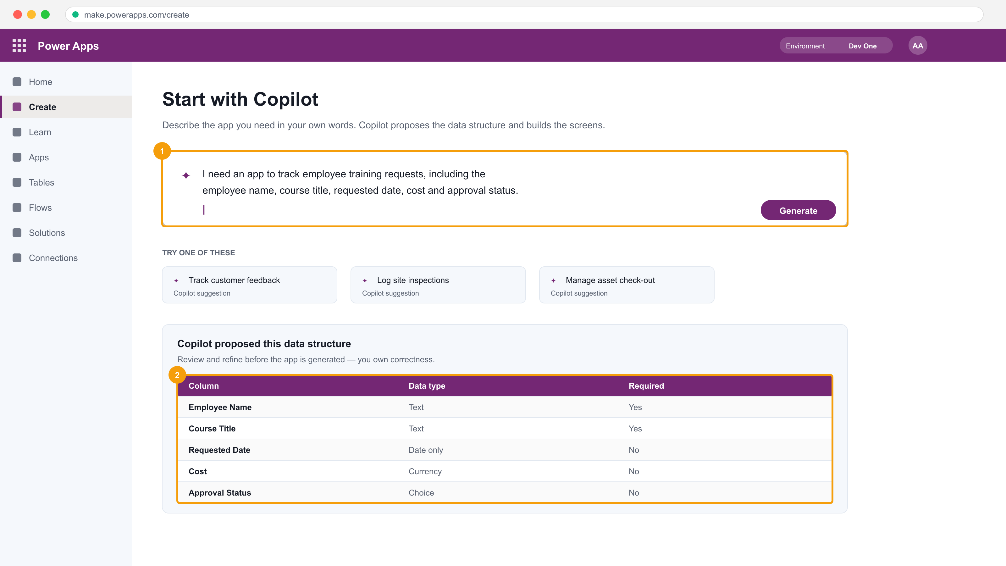
TOPIC 1 · THE INTERFACE
Copilot in Power Apps — Describe It to Design It
1
The prompt box. A natural-language description of the outcome you want.
2
The proposed data structure. Review the column names and data types, and refine by prompting again — before the app is generated.
Applied in Lab 2 — you will describe an app, refine the data structure by prompt, then generate and inspect it.
TGS-2023036648 · Power Apps & Power Automate with Copilot
© 2026 Tertiary Infotech Academy Pte Ltd
26

Slide 27
TOPIC 1 · PROMPTS
What Makes a Prompt Work
Be specific
"Track employee training requests" beats "an HR app".
Name the fields
List the columns you know you need, and their meaning.
1
2
State the outcome
Describe what the app must let someone DO.
Iterate, don't restart
Refine with a follow-up prompt rather than starting over.
3
4
Review everything
Copilot proposes; you verify names, types and relationships.
Know the goal first
If you cannot state the outcome, the copilot cannot either.
5
6
TGS-2023036648 · Power Apps & Power Automate with Copilot
© 2026 Tertiary Infotech Academy Pte Ltd
27

Slide 28
TOPIC 1 · TSC A2 · FEASIBILITY
Feasibility Scan — Can This Integration Actually Be Built?
YES — build it on the connector
Does a standard
connector exist for
BOTH systems, within
the licence you have?
Use the standard connector. Confirm the action you need exists, then check throttling limits and the data volume.
NO — escalate the design
Consider a premium connector (licence cost), a custom connector over the vendor's API, or HTTP with authentication.
This decision is the TSC A2 deliverable. In Lab 1 you record the result for ten connectors in connector-scan.csv — that file is your evidence of a feasibility scan.
TGS-2023036648 · Power Apps & Power Automate with Copilot
© 2026 Tertiary Infotech Academy Pte Ltd
28

Slide 29
TOPIC 1 · THE HONEST FRAMING
Copilot accelerates. It does not absolve.
Prototyping, inspiration and task completion are real gains. But the maker still owns the data model, the correctness of the formulas and the security of the result — and that is exactly what the assessment tests.
TGS-2023036648 · Power Apps & Power Automate with Copilot
© 2026 Tertiary Infotech Academy Pte Ltd
29

Slide 30
2
TOPIC 02
Use Copilot in Power Apps
Maker-facing Copilot · user-facing Copilot · what it generates · what you must review
TGS-2023036648 · Power Apps & Power Automate with Copilot
© 2026 Tertiary Infotech Academy Pte Ltd
30

Slide 31
TOPIC 2 · CONCEPT
Maker-Facing and User-Facing Copilot Are Different Things
Maker-facing Copilot
User-facing Copilot
Who uses it
You, while BUILDING the app
The end user, while USING the app
What it does
Proposes a data structure, generates screens, edits controls
Answers questions about the data in the app
Where it appears
The maker portal and Power Apps Studio
A Copilot control on a screen
What it changes
The app itself
Nothing — it reads and answers
Built in
Lab 2
Lab 2 (optional extension)
WHEN IT MATTERS Adding the user-facing Copilot control lets a user ask 'how many requests are still pending?' in natural language, over the same data the gallery shows.
TGS-2023036648 · Power Apps & Power Automate with Copilot
© 2026 Tertiary Infotech Academy Pte Ltd
31

Slide 32
TOPIC 2 · WHAT YOU OWN
What Copilot Generates — and What You Must Check
A data structure
Column names and DATA TYPES. Check Currency is Currency, dates are Date only, and choices are Choice.
Screens and controls
A browse, detail and edit screen. Check the gallery's Items and the form's DataSource.
1
2
Power Fx formulas
It writes real formulas. Check delegation, and that filters use the right column.
Nothing about security
Copilot does NOT set security roles or sharing. That remains entirely yours.
3
4
Nothing about performance
It will happily generate a non-delegable filter. You own the fix.
A starting point
Every generated artefact is a draft you review, correct and extend.
5
6
TGS-2023036648 · Power Apps & Power Automate with Copilot
© 2026 Tertiary Infotech Academy Pte Ltd
32

Slide 33
3
TOPIC 03
Use Copilot in Power Automate
Describing a flow · explaining actions · adding and replacing actions
TGS-2023036648 · Power Apps & Power Automate with Copilot
© 2026 Tertiary Infotech Academy Pte Ltd
33

Slide 34
TOPIC 3 · CONCEPT
What Copilot for Power Automate Can Actually Do
Build from a description
'When a new item is added to my list, email me the details' becomes a real flow with a trigger and actions.
Explain an action
Ask what a step does and why it is there — useful on a flow someone else built.
1
2
Add an action
'Also post it to Teams' inserts the action in the right place, already wired to the earlier outputs.
Replace an action
Swap one connector action for another without rebuilding the surrounding steps.
3
4
Answer questions
Ask about connectors, expressions or why a run failed.
NOT design the process
It automates the process you describe. Deciding what SHOULD be automated is still your judgement.
5
6
TGS-2023036648 · Power Apps & Power Automate with Copilot
© 2026 Tertiary Infotech Academy Pte Ltd
34

Slide 35
TOPIC 3 · THE JUDGEMENT THAT STAYS YOURS
Copilot builds the flow. You still own the trigger.
The trigger is a statement about who or what may start a business process — and that is a design decision, not a generation task. Read what Copilot chose, and change it if the wrong thing is allowed to start the process.
TGS-2023036648 · Power Apps & Power Automate with Copilot
© 2026 Tertiary Infotech Academy Pte Ltd
35

Slide 36
4
TOPIC 04
Use Copilot in Power Pages
Generating a site · theming and pages · Dataverse-backed lists and forms · permissions
TGS-2023036648 · Power Apps & Power Automate with Copilot
© 2026 Tertiary Infotech Academy Pte Ltd
36

Slide 37
TOPIC 4 · CONCEPT
How a Power Pages Site Reaches Real Data
1
2
3
4
5
Describe the site
Data workspace
Add a form
Set table permissions
Preview, then publish
Copilot proposes the pages
point a list at a table
Insert, Edit or Read-only
who may read or write
test signed-in and anonymous
PERMISSIONS ARE THE WHOLE POINT
A Power Pages site is EXTERNAL-facing. Table permissions and web roles decide what an anonymous visitor can see — get this wrong and you have published your Dataverse to the internet.
TGS-2023036648 · Power Apps & Power Automate with Copilot
© 2026 Tertiary Infotech Academy Pte Ltd
37

Slide 38
TOPIC 4 · SCOPE
What Copilot Generates for a Power Pages Site
Theming
A colour scheme and typography you can then edit.
Standard pages
Home, about and contact pages as a starting structure.
1
2
AI-generated images
Stock imagery matched to your description.
Text content
Headings and descriptive copy — review it for accuracy before publishing.
3
4
NOT the data binding
You add Dataverse lists and forms yourself, in the Data workspace.
NOT the permissions
Table permissions and web roles are always your decision.
5
6
TGS-2023036648 · Power Apps & Power Automate with Copilot
© 2026 Tertiary Infotech Academy Pte Ltd
38

Slide 39
WHAT YOU'LL DO
Hands-On Labs — Get Started with Copilot for Microsoft Power Platform
Labs 1–2
Labs 3–4
—
• Validate the Lab Environment and Explore Copilot
• Use Copilot to Build a Canvas App from a Description
• Build a Cloud Flow with Copilot for Power Automate
• Use Copilot to Build a Power Pages Site
• —
TGS-2023036648 · Power Apps & Power Automate with Copilot
© 2026 Tertiary Infotech Academy Pte Ltd
39

Slide 40
LU1 · HANDS-ON
Validate the Lab Environment and Explore Copilot
LAB 1
A1/A2 — Identify connection opportunities in Power Platform and scan the environment for feasibility.
Sign in to the Power Apps maker portal, confirm you are in the correct environment, verify that Dataverse and the Copilot features are available, and take an inventory of the connectors your tenant can actually reach.
YOU'LL BUILD
TOOLCHAIN
DONE WHEN
A validated maker environment with a documented connector feasibility scan (mock-data/connector-scan.csv).
Power Apps maker portal, Power Platform admin centre, Dataverse, Copilot
Tables load in the chosen environment, all four connections show Connected, and connector-scan.csv records the feasibility result for each.
TGS-2023036648 · Power Apps & Power Automate with Copilot
© 2026 Tertiary Infotech Academy Pte Ltd
40

Slide 41
LAB 1 · PROCESS MAP
How Lab 1 Runs
1
2
3
4
5
Sign in
Pick the environment
Check Dataverse
Create connections
Record feasibility
maker portal
one for every lab
tables must load
four connectors
connector-scan.csv
THE POINT
A1/A2 — Identify connection opportunities in Power Platform and scan the environment for feasibility.
TGS-2023036648 · Power Apps & Power Automate with Copilot
© 2026 Tertiary Infotech Academy Pte Ltd
41

Slide 42
LAB 1 · VERIFY
Validate the Lab Environment and Explore Copilot
✅ Expected result
Tables load in the chosen environment, all four connections show Connected, and connector-scan.csv records the feasibility result for each.
IF IT DOESN'T WORK
Nothing appears
Permission or 403 error
Step-by-step needed
Confirm you are in the environment the trainer named — apps, flows and agents must share one.
Sharing an app does not share its data. Check the Dataverse security role.
Every numbered step, with the exact click path, is in the Learner Guide and labs/lab-01/README.md.
TGS-2023036648 · Power Apps & Power Automate with Copilot
© 2026 Tertiary Infotech Academy Pte Ltd
42

Slide 43
LU1 · HANDS-ON
Use Copilot to Build a Canvas App from a Description
LAB 2
A1/A3 — Use Copilot to turn a natural-language need into a working app over a generated data structure.
Describe an app in plain English and let Copilot propose a data structure and screens. Iterate on the proposed table, then let Copilot generate the app and inspect what it produced.
YOU'LL BUILD
TOOLCHAIN
DONE WHEN
A Copilot-generated canvas app over a Dataverse table, with the generated data structure reviewed and corrected.
Power Apps, Copilot for Power Apps, Dataverse
The app opens in Preview, a record added in the form appears in the gallery, and the Dataverse table contains the two columns you added by prompt.
TGS-2023036648 · Power Apps & Power Automate with Copilot
© 2026 Tertiary Infotech Academy Pte Ltd
43

Slide 44
LAB 2 · PROCESS MAP
How Lab 2 Runs
1
2
3
4
5
Describe the app
Review the structure
Refine by prompt
Generate
Inspect
natural language
names and types
add two columns
Copilot builds it
read the Items formula
THE POINT
A1/A3 — Use Copilot to turn a natural-language need into a working app over a generated data structure.
TGS-2023036648 · Power Apps & Power Automate with Copilot
© 2026 Tertiary Infotech Academy Pte Ltd
44

Slide 45
LAB 2 · VERIFY
Use Copilot to Build a Canvas App from a Description
✅ Expected result
The app opens in Preview, a record added in the form appears in the gallery, and the Dataverse table contains the two columns you added by prompt.
IF IT DOESN'T WORK
Nothing appears
Permission or 403 error
Step-by-step needed
Confirm you are in the environment the trainer named — apps, flows and agents must share one.
Sharing an app does not share its data. Check the Dataverse security role.
Every numbered step, with the exact click path, is in the Learner Guide and labs/lab-02/README.md.
TGS-2023036648 · Power Apps & Power Automate with Copilot
© 2026 Tertiary Infotech Academy Pte Ltd
45

Slide 46
LU1 · HANDS-ON
Build a Cloud Flow with Copilot for Power Automate
LAB 3
A3/A5 — Use Copilot to assemble a flow, then read and test what it built.
Use Copilot in Power Automate to build a flow from a description, then examine the trigger and actions it chose, correct them, and test the run.
YOU'LL BUILD
TOOLCHAIN
DONE WHEN
A working Copilot-built cloud flow that emails a summary when a new item is created.
Power Automate, Copilot for Power Automate, Outlook, SharePoint
The run history shows a Succeeded run, the email arrives with the item's field values, and you can point at the action output that supplied each value.
TGS-2023036648 · Power Apps & Power Automate with Copilot
© 2026 Tertiary Infotech Academy Pte Ltd
46

Slide 47
LAB 3 · PROCESS MAP
How Lab 3 Runs
1
2
3
4
5
Prompt Copilot
Read the draft
Supply connections
Extend
Test and read history
describe the automation
trigger and actions
site and list
ask for a Teams post
inputs and outputs
THE POINT
A3/A5 — Use Copilot to assemble a flow, then read and test what it built.
TGS-2023036648 · Power Apps & Power Automate with Copilot
© 2026 Tertiary Infotech Academy Pte Ltd
47

Slide 48
LAB 3 · VERIFY
Build a Cloud Flow with Copilot for Power Automate
✅ Expected result
The run history shows a Succeeded run, the email arrives with the item's field values, and you can point at the action output that supplied each value.
IF IT DOESN'T WORK
Nothing appears
Permission or 403 error
Step-by-step needed
Confirm you are in the environment the trainer named — apps, flows and agents must share one.
Sharing an app does not share its data. Check the Dataverse security role.
Every numbered step, with the exact click path, is in the Learner Guide and labs/lab-03/README.md.
TGS-2023036648 · Power Apps & Power Automate with Copilot
© 2026 Tertiary Infotech Academy Pte Ltd
48

Slide 49
LU1 · HANDS-ON
Use Copilot to Build a Power Pages Site
LAB 4
A1/A4 — Generate an external-facing site and connect it to Dataverse data through its API layer.
Describe a public-facing site to Copilot in Power Pages, review the theming, pages and AI-generated content it produces, then add a Dataverse-backed form so the site reads and writes real data.
YOU'LL BUILD
TOOLCHAIN
DONE WHEN
A published Power Pages site with a Dataverse-backed page and a working form.
Power Pages, Copilot for Power Pages, Dataverse
The previewed site lists courses from Dataverse and a submitted request creates a new row in the Dataverse table.
TGS-2023036648 · Power Apps & Power Automate with Copilot
© 2026 Tertiary Infotech Academy Pte Ltd
49

Slide 50
LAB 4 · PROCESS MAP
How Lab 4 Runs
1
2
3
4
5
Describe the site
Review theme
Bind Dataverse
Set permissions
Preview and submit
Copilot proposes pages
edit the hero
list and form
anonymous vs signed-in
row lands in the table
THE POINT
A1/A4 — Generate an external-facing site and connect it to Dataverse data through its API layer.
TGS-2023036648 · Power Apps & Power Automate with Copilot
© 2026 Tertiary Infotech Academy Pte Ltd
50

Slide 51
LAB 4 · VERIFY
Use Copilot to Build a Power Pages Site
✅ Expected result
The previewed site lists courses from Dataverse and a submitted request creates a new row in the Dataverse table.
IF IT DOESN'T WORK
Nothing appears
Permission or 403 error
Step-by-step needed
Confirm you are in the environment the trainer named — apps, flows and agents must share one.
Sharing an app does not share its data. Check the Dataverse security role.
Every numbered step, with the exact click path, is in the Learner Guide and labs/lab-04/README.md.
TGS-2023036648 · Power Apps & Power Automate with Copilot
© 2026 Tertiary Infotech Academy Pte Ltd
51

Slide 52
LEARNING UNIT RECAP · YOU CAN NOW
Recap — Get Started with Copilot for Microsoft Power Platform
Lab 1 — Validate the Lab Environment and Explore Copilot
A1/A2 — Identify connection opportunities in Power Platform and scan the environment for feasibility.
Lab 2 — Use Copilot to Build a Canvas App from a Description
A1/A3 — Use Copilot to turn a natural-language need into a working app over a generated data structure.
1
2
Lab 3 — Build a Cloud Flow with Copilot for Power Automate
A3/A5 — Use Copilot to assemble a flow, then read and test what it built.
Lab 4 — Use Copilot to Build a Power Pages Site
A1/A4 — Generate an external-facing site and connect it to Dataverse data through its API layer.
3
4
TGS-2023036648 · Power Apps & Power Automate with Copilot
© 2026 Tertiary Infotech Academy Pte Ltd
52

Slide 53
2
LU2
Create and Manage Canvas Apps with Power Apps
Topics 5–10 · Labs 5–12
TGS-2023036648 · Power Apps & Power Automate with Copilot
© 2026 Tertiary Infotech Academy Pte Ltd
53

Slide 54
5
TOPIC 05
Get Started with Power Apps Canvas Apps
What a canvas app is · Power Fx · controls · galleries and forms
TGS-2023036648 · Power Apps & Power Automate with Copilot
© 2026 Tertiary Infotech Academy Pte Ltd
54

Slide 55
TOPIC 5 · CONCEPT
Canvas App or Model-Driven App — Which One?
Canvas app
Model-driven app
You design
Pixel-precise screens you draw
Components generated from the data model
Starts from
A blank screen or a data source
The Dataverse tables themselves
Data source
Any of 1,000+ connectors
Dataverse only
Layout control
Total — you place every control
Configured, not drawn
Best for
Task-focused, mobile, branded UX
Data-heavy, process-driven business apps
In this course
Labs 5–12
Labs 21–24
WHEN IT MATTERS Neither is 'better'. Choose canvas when the experience matters most; choose model-driven when the data model and process matter most. LU2 builds one of each.
TGS-2023036648 · Power Apps & Power Automate with Copilot
© 2026 Tertiary Infotech Academy Pte Ltd
55

Slide 56
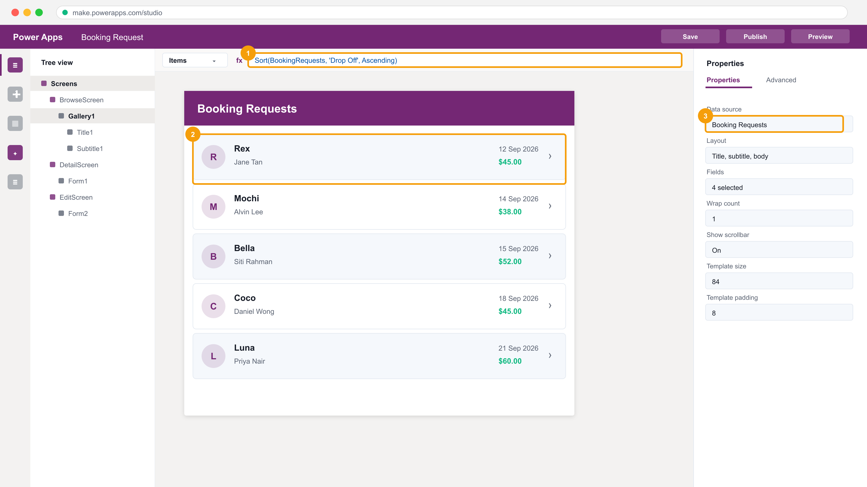
TOPIC 5 · THE INTERFACE
Power Apps Studio — Where You Will Spend LU2
1
The formula bar. Select a property on the left, then write the Power Fx expression that produces its value.
2
The gallery — one control that repeats a template for every record in its Items collection.
3
The properties pane. Everything here can also be set as a formula in the bar above.
Three panes: the tree view of every control, the canvas you are designing, and the properties of whatever is selected.
TGS-2023036648 · Power Apps & Power Automate with Copilot
© 2026 Tertiary Infotech Academy Pte Ltd
56

Slide 57
TOPIC 5 · POWER FX
Power Fx — A Property Is an Expression, Not a Script
Power Fx is declarative and recalculates automatically, exactly like an Excel cell. There is no 'run' — you never write a loop to fill a gallery.
// Gallery1.Items — the rows to show
Sort(
Filter('Booking Requests',
Status.Value = "Requested"),
'Drop Off', Ascending
)
// Label1.Text — recalculates by itself
"Showing " & CountRows(Gallery1.AllItems)
& " pending requests"
// Button.OnSelect — actions, in order
Patch('Booking Requests',
Gallery1.Selected,
{Status: {Value: "Confirmed"}});
Notify("Booking confirmed", Success)
Declarative
You state what a property IS. When the data changes, every dependent property recalculates on its own.
Filter then Sort
Filter narrows the rows, Sort orders them. Both should be delegable so the server does the work.
& concatenates
One expression can mix literals, functions and control properties.
; sequences behaviour
Only behaviour properties (OnSelect, OnVisible) take a ;-separated sequence.
TGS-2023036648 · Power Apps & Power Automate with Copilot
© 2026 Tertiary Infotech Academy Pte Ltd
57

Slide 58
TOPIC 5 · CONTROLS
The Controls You Will Actually Use
Label
Displays text. Its Text property is a formula.
Gallery
Repeats a template for every record in Items.
1
2
Form (Display / Edit)
Shows or edits ONE record — the Item property.
Text input
Collects typed input; read it back as .Text.
3
4
Button / Icon
Runs a behaviour formula in OnSelect.
Dropdown / Combo box
Choose from a list or a related table.
5
6
TGS-2023036648 · Power Apps & Power Automate with Copilot
© 2026 Tertiary Infotech Academy Pte Ltd
58

Slide 59
6
TOPIC 06
Customize a Canvas App in Power Apps
Formulas · screen navigation · the data model · variables and collections
TGS-2023036648 · Power Apps & Power Automate with Copilot
© 2026 Tertiary Infotech Academy Pte Ltd
59

Slide 60
TOPIC 6 · CONCEPT
How Data Reaches the Screen
1
2
3
4
5
Data source
Connector
Items property
Gallery / Form
The screen
Excel, SharePoint, Dataverse
the middleware (TSC A3)
a Power Fx expression
the control that renders it
what the user sees
THE CHAIN IS THE INTEGRATION
Every canvas app is this chain. When data does not appear, you debug the chain one link at a time — which is exactly the Lab 26 method.
TGS-2023036648 · Power Apps & Power Automate with Copilot
© 2026 Tertiary Infotech Academy Pte Ltd
60

Slide 61
TOPIC 6 · STATE
Where to Keep a Value — Three Kinds of State
Global variable
Context variable
Collection
Set with
Set(gblUser, …)
UpdateContext({locX: …})
ClearCollect(colX, …)
Scope
The whole app
One screen only
The whole app
Holds
A single value or record
A single value or record
A TABLE of records
Survives navigation
Yes
No
Yes
Typical use
Signed-in user, app settings
Show/hide a panel on this screen
Offline cache, staged edits
Lab
Lab 8
Lab 10
Lab 9
WHEN IT MATTERS Reach for a variable only when a formula cannot express it directly. Power Fx recalculates automatically — an unnecessary variable is state you now have to keep correct yourself.
TGS-2023036648 · Power Apps & Power Automate with Copilot
© 2026 Tertiary Infotech Academy Pte Ltd
61

Slide 62
TOPIC 6 · NAVIGATION
Navigation Between Screens
Navigate(Screen2)
Go to another screen.
Navigate(Screen2, ScreenTransition.Cover)
Go, with a transition.
1
2
Navigate(Screen2, None, {locId: ThisItem.ID})
Go, passing context.
Back()
Return to the previous screen — remembers where you came from.
3
4
Gallery1.Selected
The record the user picked — how a detail screen knows what to show.
NewForm(Form1); Navigate(EditScreen)
Open a blank form to create a record.
5
6
TGS-2023036648 · Power Apps & Power Automate with Copilot
© 2026 Tertiary Infotech Academy Pte Ltd
62

Slide 63
7
TOPIC 07
How to Build the User Interface in a Canvas App
Themes · branding · fonts and icons · personalisation · responsive layout
TGS-2023036648 · Power Apps & Power Automate with Copilot
© 2026 Tertiary Infotech Academy Pte Ltd
63

Slide 64
TOPIC 7 · CONCEPT
Building a UI People Can Actually Use
Theme first, then override
Settings › Theme restyles every control at once. Override individual controls afterwards.
Font
Available on any control that displays text — 14 built-in fonts, or type any font name.
1
2
Icons over labels
An icon needs no text and fits where a label will not — the floppy disk for Save, the arrow for Back.
Colour with meaning
Use colour to signal state (Confirmed / Declined), not decoration.
3
4
Personalise
User().FullName and Office365Users.UserPhotoV2() greet the signed-in person.
Design for the target
Tablet and phone layouts differ. Set X/Y and Width as formulas so the layout holds.
5
6
TGS-2023036648 · Power Apps & Power Automate with Copilot
© 2026 Tertiary Infotech Academy Pte Ltd
64

Slide 65
8
TOPIC 08
Work with External Data in a Power Apps Canvas App
Connectors · SharePoint · collections · Patch · delegation
TGS-2023036648 · Power Apps & Power Automate with Copilot
© 2026 Tertiary Infotech Academy Pte Ltd
65

Slide 66
TOPIC 8 · CONNECTORS
Connectors Are the Middleware (TSC A3)
Excel Online (Business)
Binds to a NAMED TABLE inside a workbook in OneDrive. Lab 5.
SharePoint
Lists behave like tables; choice columns need {Value: "…"}. Lab 9.
1
2
Dataverse
The native store — relationships, choices, security roles. Labs 6, 7, 10.
Office 365 Users
Profile, photo and manager of the signed-in user. Lab 8.
3
4
SQL Server (premium)
Direct table access — check the licence before you design on it.
Custom connector / HTTP
When no standard connector exists — the TSC A4 API-level path.
5
6
TGS-2023036648 · Power Apps & Power Automate with Copilot
© 2026 Tertiary Infotech Academy Pte Ltd
66

Slide 67
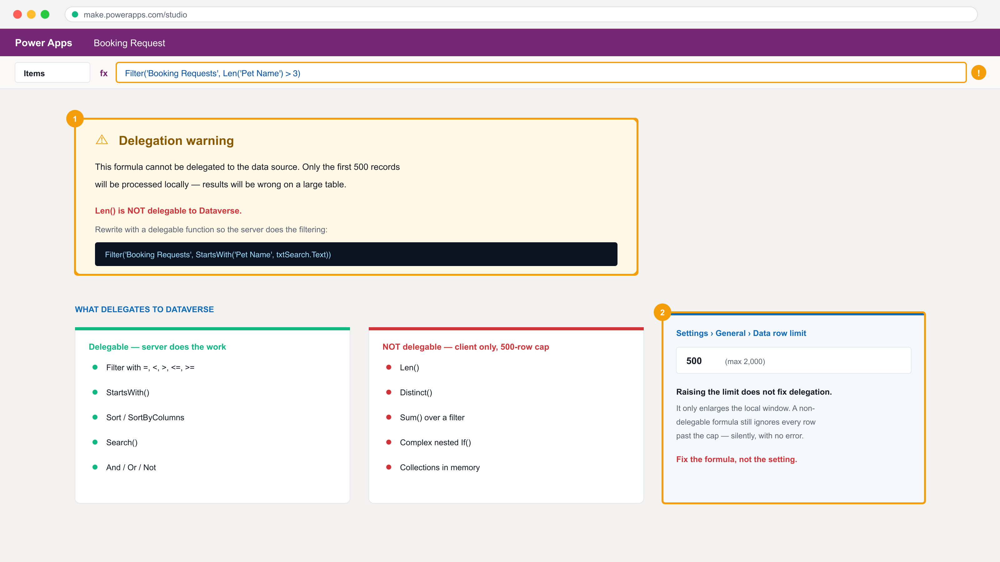
TOPIC 8 · TSC A7 · PERFORMANCE
Delegation — The Silent Failure You Must Recognise
1
The blue warning. The formula cannot be delegated, so only the first 500 rows are processed — locally.
2
Raising the data row limit does NOT fix it. It only enlarges the local window. Fix the formula instead.
A non-delegable formula does not error. It silently returns wrong answers as soon as the table outgrows the cap — the classic TSC A7 performance issue.
TGS-2023036648 · Power Apps & Power Automate with Copilot
© 2026 Tertiary Infotech Academy Pte Ltd
67

Slide 68
TOPIC 8 · WRITING DATA
Writing Data — Patch, SubmitForm and Collections
Three ways to write. Choose by how much control you need over the record and the moment of the write.
// 1 — Patch: write specific fields
Patch('Kennel Bookings',
ThisItem,
{Status: {Value: "Confirmed"}})
// 2 — Patch: create a NEW record
Patch('Booking Requests',
Defaults('Booking Requests'),
{'Pet Name': txtPet.Text,
'Owner Name': txtOwner.Text})
// 3 — SubmitForm: commit a whole Form
SubmitForm(Form2)
// Load rows into memory (client-side)
ClearCollect(colBookings,
'Kennel Bookings')
Patch updates
Give it the data source, the record and only the fields to change.
Defaults() creates
Patching over Defaults() inserts a new row instead of updating one.
SubmitForm commits
The Form validates required fields first, then writes — use OnSuccess to navigate.
ClearCollect caches
A collection is a client-side table. It does not write back until you Patch it.
TGS-2023036648 · Power Apps & Power Automate with Copilot
© 2026 Tertiary Infotech Academy Pte Ltd
68

Slide 69
9
TOPIC 09
Write Data in a Power Apps Canvas App
Form controls · SubmitForm · validation · errors · LastSubmit
TGS-2023036648 · Power Apps & Power Automate with Copilot
© 2026 Tertiary Infotech Academy Pte Ltd
69

Slide 70
TOPIC 9 · FORMS
The Form Control — Modes and What Each One Does
Mode
Set by
What the user sees
Commit with
FormMode.View
ViewForm(Form1)
Read-only display of the record
— (nothing to commit)
FormMode.Edit
EditForm(Form1)
Editable fields for an EXISTING record
SubmitForm(Form1)
FormMode.New
NewForm(Form1)
Blank fields for a NEW record
SubmitForm(Form1)
WHEN IT MATTERS A Form's Item property says WHICH record; its Mode says what the user may do with it. Set Mode with the function, then let OnSuccess navigate away and OnFailure show Form1.Error.
TGS-2023036648 · Power Apps & Power Automate with Copilot
© 2026 Tertiary Infotech Academy Pte Ltd
70

Slide 71
TOPIC 9 · VERIFICATION
Verifying a Write Actually Happened (TSC A5)
Form1.Error
The error message text from the last failed submit — put it in a Label.
Form1.LastSubmit
The whole record as written, including the server-generated ID.
1
2
OnSuccess
Fires only when the write succeeded — the right place to Back() or Notify().
OnFailure
Fires when it did not — show the error rather than failing silently.
3
4
Check the source
Open the Dataverse table or SharePoint list and confirm the row changed.
Required columns
A Business-required column blocks the submit until it has a value.
5
6
TGS-2023036648 · Power Apps & Power Automate with Copilot
© 2026 Tertiary Infotech Academy Pte Ltd
71

Slide 72
10
TOPIC 10
Publish, Share and Maintain a Canvas App
Publishing · sharing and permissions · versions · export · PCF components
TGS-2023036648 · Power Apps & Power Automate with Copilot
© 2026 Tertiary Infotech Academy Pte Ltd
72

Slide 73
TOPIC 10 · LIFECYCLE
From Maker to Governed Asset
1
2
3
4
5
Save
Publish
Share
Data permission
Monitor & restore
a new version is created
that version goes live
grant Can use / Co-owner
share the SOURCE too
versions, Monitor, export
SHARING THE APP IS NOT SHARING THE DATA
A user with Can use on the app but no Dataverse security role opens the app and sees an error. This is the most common support call after a launch — and Lab 12 makes you reproduce it deliberately.
TGS-2023036648 · Power Apps & Power Automate with Copilot
© 2026 Tertiary Infotech Academy Pte Ltd
73

Slide 74
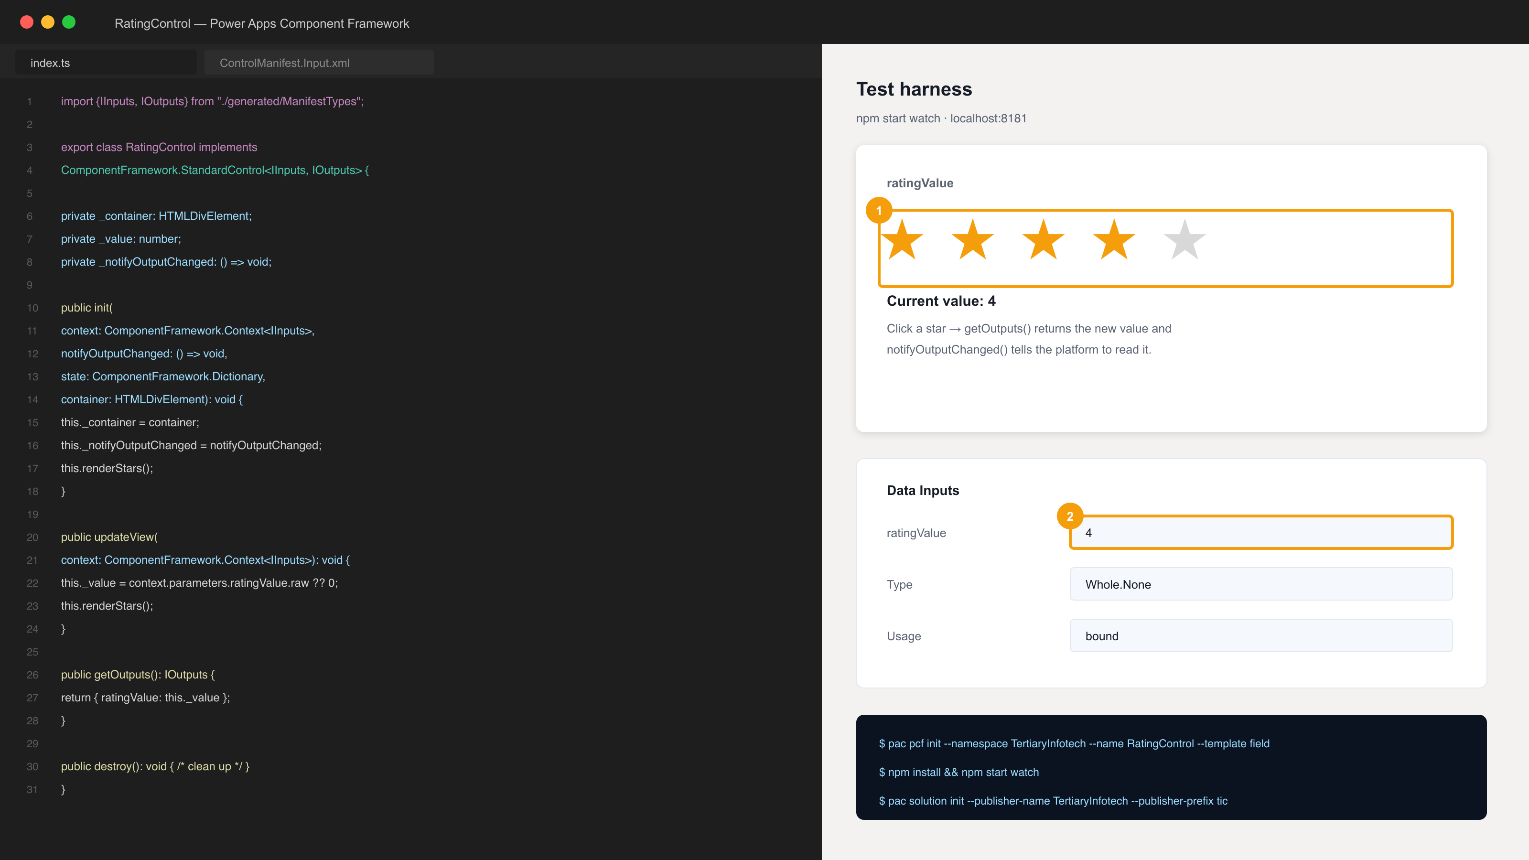
TOPIC 10 · TSC A4 / A8
Extending the Platform with a Code Component (PCF)
1
The rendered control in the local test harness — npm start watch, before any tenant is involved.
2
The bound property declared in the manifest. Its type must match the column you bind it to.
The Power Apps Component Framework is the API-level extension point: TypeScript in, a solution package out, usable in canvas and model-driven apps. Built in Lab 11.
TGS-2023036648 · Power Apps & Power Automate with Copilot
© 2026 Tertiary Infotech Academy Pte Ltd
74

Slide 75
WHAT YOU'LL DO
Hands-On Labs — Create and Manage Canvas Apps with Power Apps
Labs 5–7
Labs 8–10
Labs 11–12
• Create a Canvas App from Excel Data
• Build the Dataverse Data Model
• Create a Canvas App over Dataverse
• Build and Theme the User Interface
• Work with External Data — SharePoint, Collections and Patch
• Write Data with Forms
• Extend the App with a Code Component (PCF)
• Publish, Share and Maintain the App
TGS-2023036648 · Power Apps & Power Automate with Copilot
© 2026 Tertiary Infotech Academy Pte Ltd
75

Slide 76
LU2 · HANDS-ON
Create a Canvas App from Excel Data
LAB 5
A3 — Utilise a connector as middleware to integrate Excel data into an application.
Upload an Excel workbook to OneDrive for Business, connect Power Apps to its table through the Excel Online (Business) connector, and generate a three-screen canvas app from that data.
YOU'LL BUILD
TOOLCHAIN
DONE WHEN
A three-screen canvas app (browse, detail, edit) over an Excel table in OneDrive.
Power Apps, Excel Online (Business), OneDrive for Business
The app previews with data from Excel, and an edit made in the app appears in the Excel workbook in OneDrive.
TGS-2023036648 · Power Apps & Power Automate with Copilot
© 2026 Tertiary Infotech Academy Pte Ltd
76

Slide 77
LAB 5 · PROCESS MAP
How Lab 5 Runs
1
2
3
4
5
Upload to OneDrive
Start from data
Select the table
Generate three screens
Edit and verify
a named Excel table
Excel connector
inside the workbook
browse, detail, edit
the write reaches Excel
THE POINT
A3 — Utilise a connector as middleware to integrate Excel data into an application.
TGS-2023036648 · Power Apps & Power Automate with Copilot
© 2026 Tertiary Infotech Academy Pte Ltd
77

Slide 78
LAB 5 · VERIFY
Create a Canvas App from Excel Data
✅ Expected result
The app previews with data from Excel, and an edit made in the app appears in the Excel workbook in OneDrive.
IF IT DOESN'T WORK
Nothing appears
Permission or 403 error
Step-by-step needed
Confirm you are in the environment the trainer named — apps, flows and agents must share one.
Sharing an app does not share its data. Check the Dataverse security role.
Every numbered step, with the exact click path, is in the Learner Guide and labs/lab-05/README.md.
TGS-2023036648 · Power Apps & Power Automate with Copilot
© 2026 Tertiary Infotech Academy Pte Ltd
78

Slide 79
LU2 · HANDS-ON
Build the Dataverse Data Model
LAB 6
A1/A3 — Design tables, columns and a relationship as the integration point for apps and flows.
Create a Booking Request table in Dataverse with typed columns, then create a second table and join them with a lookup column so one row can reference another.
YOU'LL BUILD
TOOLCHAIN
DONE WHEN
Two related Dataverse tables with a lookup relationship and seeded rows.
Power Apps, Microsoft Dataverse
Booking Request shows the imported rows, the Status choice renders as a dropdown, and the Kennel lookup resolves to a Kennel row.
TGS-2023036648 · Power Apps & Power Automate with Copilot
© 2026 Tertiary Infotech Academy Pte Ltd
79

Slide 80
LAB 6 · PROCESS MAP
How Lab 6 Runs
1
2
3
4
5
Create the table
Add typed columns
Add a Choice
Add a Lookup
Import the rows
primary column first
text, date, currency
an option set
this IS the relationship
from mock-data
THE POINT
A1/A3 — Design tables, columns and a relationship as the integration point for apps and flows.
TGS-2023036648 · Power Apps & Power Automate with Copilot
© 2026 Tertiary Infotech Academy Pte Ltd
80

Slide 81
LAB 6 · VERIFY
Build the Dataverse Data Model
✅ Expected result
Booking Request shows the imported rows, the Status choice renders as a dropdown, and the Kennel lookup resolves to a Kennel row.
IF IT DOESN'T WORK
Nothing appears
Permission or 403 error
Step-by-step needed
Confirm you are in the environment the trainer named — apps, flows and agents must share one.
Sharing an app does not share its data. Check the Dataverse security role.
Every numbered step, with the exact click path, is in the Learner Guide and labs/lab-06/README.md.
TGS-2023036648 · Power Apps & Power Automate with Copilot
© 2026 Tertiary Infotech Academy Pte Ltd
81

Slide 82
LU2 · HANDS-ON
Create a Canvas App over Dataverse
LAB 7
A3 — Bind a hand-built canvas app to Dataverse and format the data it displays.
Build a canvas app from blank, add Dataverse as a data source, lay out the main screen and add a gallery bound to the Booking Request table with formatted fields.
YOU'LL BUILD
TOOLCHAIN
DONE WHEN
A canvas app with a formatted, sorted gallery over the Booking Request table.
Power Apps, Microsoft Dataverse, Power Fx
The gallery lists the Dataverse rows sorted by drop-off date, with dates and currency correctly formatted.
TGS-2023036648 · Power Apps & Power Automate with Copilot
© 2026 Tertiary Infotech Academy Pte Ltd
82

Slide 83
LAB 7 · PROCESS MAP
How Lab 7 Runs
1
2
3
4
5
Blank canvas app
Add Dataverse
Insert a gallery
Sort and map fields
Format
tablet format
the data source
bind Items
title and subtitle
dates and currency
THE POINT
A3 — Bind a hand-built canvas app to Dataverse and format the data it displays.
TGS-2023036648 · Power Apps & Power Automate with Copilot
© 2026 Tertiary Infotech Academy Pte Ltd
83

Slide 84
LAB 7 · VERIFY
Create a Canvas App over Dataverse
✅ Expected result
The gallery lists the Dataverse rows sorted by drop-off date, with dates and currency correctly formatted.
IF IT DOESN'T WORK
Nothing appears
Permission or 403 error
Step-by-step needed
Confirm you are in the environment the trainer named — apps, flows and agents must share one.
Sharing an app does not share its data. Check the Dataverse security role.
Every numbered step, with the exact click path, is in the Learner Guide and labs/lab-07/README.md.
TGS-2023036648 · Power Apps & Power Automate with Copilot
© 2026 Tertiary Infotech Academy Pte Ltd
84

Slide 85
LU2 · HANDS-ON
Build and Theme the User Interface
LAB 8
A3/A6 — Build a consistent, branded UI and verify it renders correctly across screens.
Apply a theme to the app, brand individual controls, and personalise the screen with the signed-in user's details from the Office 365 Users connector.
YOU'LL BUILD
TOOLCHAIN
DONE WHEN
A themed, branded canvas app that greets the signed-in user by name.
Power Apps, Power Fx, Office 365 Users
The app opens themed and branded, and the header greets the signed-in user by name with their profile photo.
TGS-2023036648 · Power Apps & Power Automate with Copilot
© 2026 Tertiary Infotech Academy Pte Ltd
85

Slide 86
LAB 8 · PROCESS MAP
How Lab 8 Runs
1
2
3
4
5
Apply a theme
Override the header
Add an icon
Add Office 365 Users
Personalise
every control restyles
fill, font, colour
brand colour
the connector
greet the signed-in user
THE POINT
A3/A6 — Build a consistent, branded UI and verify it renders correctly across screens.
TGS-2023036648 · Power Apps & Power Automate with Copilot
© 2026 Tertiary Infotech Academy Pte Ltd
86

Slide 87
LAB 8 · VERIFY
Build and Theme the User Interface
✅ Expected result
The app opens themed and branded, and the header greets the signed-in user by name with their profile photo.
IF IT DOESN'T WORK
Nothing appears
Permission or 403 error
Step-by-step needed
Confirm you are in the environment the trainer named — apps, flows and agents must share one.
Sharing an app does not share its data. Check the Dataverse security role.
Every numbered step, with the exact click path, is in the Learner Guide and labs/lab-08/README.md.
TGS-2023036648 · Power Apps & Power Automate with Copilot
© 2026 Tertiary Infotech Academy Pte Ltd
87

Slide 88
LU2 · HANDS-ON
Work with External Data — SharePoint, Collections and Patch
LAB 9
A3/A4 — Integrate a second data source and write to it through API-level functions.
Create a SharePoint list, add it to the app as a second data source, load data into an in-memory collection, and use Patch to write status changes back to the list.
YOU'LL BUILD
TOOLCHAIN
DONE WHEN
A canvas app reading and writing both Dataverse and a SharePoint list, using a collection and Patch.
Power Apps, SharePoint Online, Power Fx, Office 365 Users
The SharePoint list shows the status values changed by the Confirm and Decline buttons, and colBookings appears under Variables > Collections.
TGS-2023036648 · Power Apps & Power Automate with Copilot
© 2026 Tertiary Infotech Academy Pte Ltd
88

Slide 89
LAB 9 · PROCESS MAP
How Lab 9 Runs
1
2
3
4
5
Create the SharePoint list
Add it to the app
Gallery over the list
Collect in memory
Patch the status
a second source
+ Add data
SortByColumns
ClearCollect
write back
THE POINT
A3/A4 — Integrate a second data source and write to it through API-level functions.
TGS-2023036648 · Power Apps & Power Automate with Copilot
© 2026 Tertiary Infotech Academy Pte Ltd
89

Slide 90
LAB 9 · VERIFY
Work with External Data — SharePoint, Collections and Patch
✅ Expected result
The SharePoint list shows the status values changed by the Confirm and Decline buttons, and colBookings appears under Variables > Collections.
IF IT DOESN'T WORK
Nothing appears
Permission or 403 error
Step-by-step needed
Confirm you are in the environment the trainer named — apps, flows and agents must share one.
Sharing an app does not share its data. Check the Dataverse security role.
Every numbered step, with the exact click path, is in the Learner Guide and labs/lab-09/README.md.
TGS-2023036648 · Power Apps & Power Automate with Copilot
© 2026 Tertiary Infotech Academy Pte Ltd
90

Slide 91
LU2 · HANDS-ON
Write Data with Forms
LAB 10
A3/A5 — Use Form controls to display, edit and create records, and verify each write.
Add detail and edit screens, wire navigation between them, then use Display and Edit forms with SubmitForm and NewForm to read, update and create Dataverse records.
YOU'LL BUILD
TOOLCHAIN
DONE WHEN
A three-screen app with working display, edit, create and delete behaviour over Dataverse.
Power Apps, Microsoft Dataverse, Power Fx
A record created in the app appears in Dataverse, an edit updates the same row, and Delete removes it — verified in the table's Data tab.
TGS-2023036648 · Power Apps & Power Automate with Copilot
© 2026 Tertiary Infotech Academy Pte Ltd
91

Slide 92
LAB 10 · PROCESS MAP
How Lab 10 Runs
1
2
3
4
5
Add screens
Wire navigation
Display form
Edit form
Create and delete
detail and edit
Navigate and Back
one record, read-only
SubmitForm on save
NewForm and Remove
THE POINT
A3/A5 — Use Form controls to display, edit and create records, and verify each write.
TGS-2023036648 · Power Apps & Power Automate with Copilot
© 2026 Tertiary Infotech Academy Pte Ltd
92

Slide 93
LAB 10 · VERIFY
Write Data with Forms
✅ Expected result
A record created in the app appears in Dataverse, an edit updates the same row, and Delete removes it — verified in the table's Data tab.
IF IT DOESN'T WORK
Nothing appears
Permission or 403 error
Step-by-step needed
Confirm you are in the environment the trainer named — apps, flows and agents must share one.
Sharing an app does not share its data. Check the Dataverse security role.
Every numbered step, with the exact click path, is in the Learner Guide and labs/lab-10/README.md.
TGS-2023036648 · Power Apps & Power Automate with Copilot
© 2026 Tertiary Infotech Academy Pte Ltd
93

Slide 94
LU2 · HANDS-ON
Extend the App with a Code Component (PCF)
LAB 11
A4/A8 — Support API-level integration by building a custom control and modifying the platform's UI layer.
Use the Power Apps Component Framework to build, test and package a custom code component, then import it into the environment and place it on a canvas app screen.
YOU'LL BUILD
TOOLCHAIN
DONE WHEN
A packaged PCF code component imported as a solution and used inside the canvas app.
Power Platform CLI, Node.js, TypeScript, Power Apps Component Framework, Dataverse solutions
npm start watch renders the control in the harness, the solution imports without error, and the component can be inserted onto a canvas app screen.
TGS-2023036648 · Power Apps & Power Automate with Copilot
© 2026 Tertiary Infotech Academy Pte Ltd
94

Slide 95
LAB 11 · PROCESS MAP
How Lab 11 Runs
1
2
3
4
5
Check the toolchain
Scaffold the control
Edit manifest and code
Run the harness
Package and import
pac, Node, .NET
pcf init
bound property
npm start watch
a managed solution
THE POINT
A4/A8 — Support API-level integration by building a custom control and modifying the platform's UI layer.
TGS-2023036648 · Power Apps & Power Automate with Copilot
© 2026 Tertiary Infotech Academy Pte Ltd
95

Slide 96
LAB 11 · VERIFY
Extend the App with a Code Component (PCF)
✅ Expected result
npm start watch renders the control in the harness, the solution imports without error, and the component can be inserted onto a canvas app screen.
IF IT DOESN'T WORK
Nothing appears
Permission or 403 error
Step-by-step needed
Confirm you are in the environment the trainer named — apps, flows and agents must share one.
Sharing an app does not share its data. Check the Dataverse security role.
Every numbered step, with the exact click path, is in the Learner Guide and labs/lab-11/README.md.
TGS-2023036648 · Power Apps & Power Automate with Copilot
© 2026 Tertiary Infotech Academy Pte Ltd
96

Slide 97
LU2 · HANDS-ON
Publish, Share and Maintain the App
LAB 12
A6/A8 — Verify the app functions for other users and manage its versions and permissions.
Publish the canvas app, share it with colleagues at the right permission level, review and restore versions, and export the app package for another environment.
YOU'LL BUILD
TOOLCHAIN
DONE WHEN
A published, shared and exported canvas app with a documented version history.
Power Apps, Microsoft Entra ID, Dataverse
The published app opens from its own URL for a second signed-in user, the version history shows a restore, and the exported .zip downloads.
TGS-2023036648 · Power Apps & Power Automate with Copilot
© 2026 Tertiary Infotech Academy Pte Ltd
97

Slide 98
LAB 12 · PROCESS MAP
How Lab 12 Runs
1
2
3
4
5
Publish
Share
Note the data warning
Versions
Export
this version goes live
Can use, not Co-owner
the source is separate
review and restore
a portable package
THE POINT
A6/A8 — Verify the app functions for other users and manage its versions and permissions.
TGS-2023036648 · Power Apps & Power Automate with Copilot
© 2026 Tertiary Infotech Academy Pte Ltd
98

Slide 99
LAB 12 · VERIFY
Publish, Share and Maintain the App
✅ Expected result
The published app opens from its own URL for a second signed-in user, the version history shows a restore, and the exported .zip downloads.
IF IT DOESN'T WORK
Nothing appears
Permission or 403 error
Step-by-step needed
Confirm you are in the environment the trainer named — apps, flows and agents must share one.
Sharing an app does not share its data. Check the Dataverse security role.
Every numbered step, with the exact click path, is in the Learner Guide and labs/lab-12/README.md.
TGS-2023036648 · Power Apps & Power Automate with Copilot
© 2026 Tertiary Infotech Academy Pte Ltd
99

Slide 100
LEARNING UNIT RECAP · YOU CAN NOW
Recap — Create and Manage Canvas Apps with Power Apps (1/2)
Lab 5 — Create a Canvas App from Excel Data
A3 — Utilise a connector as middleware to integrate Excel data into an application.
Lab 6 — Build the Dataverse Data Model
A1/A3 — Design tables, columns and a relationship as the integration point for apps and flows.
1
2
Lab 7 — Create a Canvas App over Dataverse
A3 — Bind a hand-built canvas app to Dataverse and format the data it displays.
Lab 8 — Build and Theme the User Interface
A3/A6 — Build a consistent, branded UI and verify it renders correctly across screens.
3
4
TGS-2023036648 · Power Apps & Power Automate with Copilot
© 2026 Tertiary Infotech Academy Pte Ltd
100

Slide 101
LEARNING UNIT RECAP · YOU CAN NOW
Recap — Create and Manage Canvas Apps with Power Apps (2/2)
Lab 9 — Work with External Data — SharePoint, Collections and Patch
A3/A4 — Integrate a second data source and write to it through API-level functions.
Lab 10 — Write Data with Forms
A3/A5 — Use Form controls to display, edit and create records, and verify each write.
1
2
Lab 11 — Extend the App with a Code Component (PCF)
A4/A8 — Support API-level integration by building a custom control and modifying the platform's UI layer.
Lab 12 — Publish, Share and Maintain the App
A6/A8 — Verify the app functions for other users and manage its versions and permissions.
3
4
TGS-2023036648 · Power Apps & Power Automate with Copilot
© 2026 Tertiary Infotech Academy Pte Ltd
101

Slide 102
3
LU3
Automated Processes with Power Automate and Copilot Studio Agents
Topics 11–14 · Labs 13–20
TGS-2023036648 · Power Apps & Power Automate with Copilot
© 2026 Tertiary Infotech Academy Pte Ltd
102

Slide 103
11
TOPIC 11
Get Started with Power Automate
Flow anatomy · triggers · actions · dynamic content · run history
TGS-2023036648 · Power Apps & Power Automate with Copilot
© 2026 Tertiary Infotech Academy Pte Ltd
103

Slide 104
TOPIC 11 · CONCEPT
Every Flow Is the Same Four Parts
1
2
3
4
TRIGGER
ACTION
ACTION
OUTPUT
what starts it
do the work
do more work
notify or return
LEARN IT ONCE
Every flow in Labs 13–20 is this shape. Only the trigger and the actions change. A flow has exactly ONE trigger — change it and you have a different flow, even if the actions are identical.
TGS-2023036648 · Power Apps & Power Automate with Copilot
© 2026 Tertiary Infotech Academy Pte Ltd
104

Slide 105
TOPIC 11 · TRIGGERS
Four Trigger Families — Who Is Allowed to Start the Process
Family
What starts it
Example trigger
Used in
Manual
A person presses Run
Manually trigger a flow · button in Teams
Lab 15
Scheduled
A clock reaches a time
Recurrence — set the TIME ZONE
Lab 15
Automated
An event happens in a system
When a row is added · when an item is created
Labs 13, 14, 16
Request
Something calls in from outside
HTTP request received · when an agent calls the workflow
Labs 18, 19
WHEN IT MATTERS The trigger you choose is a statement about who or what may start this process. A Recurrence left on UTC runs at the wrong hour in Singapore — set the time zone explicitly.
TGS-2023036648 · Power Apps & Power Automate with Copilot
© 2026 Tertiary Infotech Academy Pte Ltd
105

Slide 106
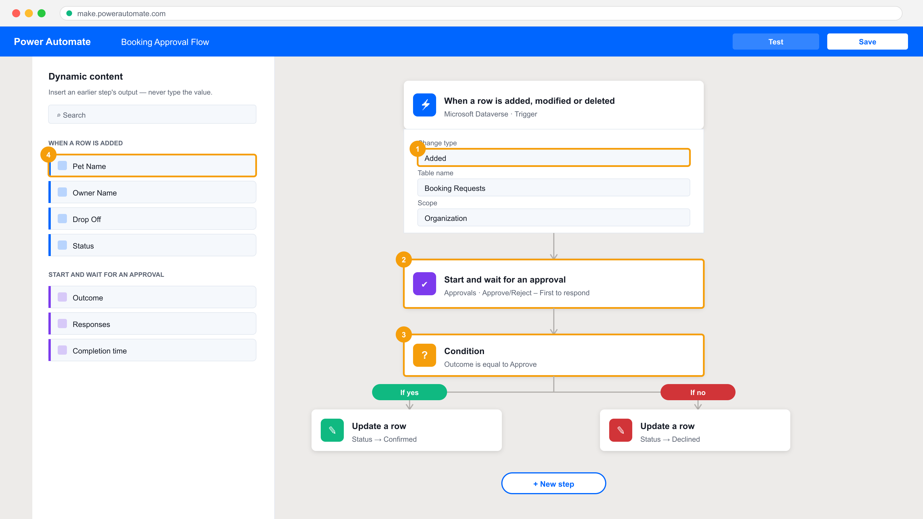
TOPIC 11 · THE INTERFACE
The Power Automate Designer
1
The trigger's own settings — which table, which change type, what scope.
2
An action. Each one runs after the one above it.
3
A Condition branches the run on a value produced earlier.
4
Dynamic content — insert an earlier step's OUTPUT as a token. Never type the value.
Applied in Labs 13–16. The left panel is the single most important habit in the course: insert, never type.
TGS-2023036648 · Power Apps & Power Automate with Copilot
© 2026 Tertiary Infotech Academy Pte Ltd
106

Slide 107
TOPIC 11 · THE HABIT
A typed value is a constant that will be wrong tomorrow.
Dynamic content inserts the actual output of an earlier step at run time. Typing the same text produces a flow that works once, for one record, and silently sends the wrong data forever after.
TGS-2023036648 · Power Apps & Power Automate with Copilot
© 2026 Tertiary Infotech Academy Pte Ltd
107

Slide 108
TOPIC 11 · VERIFICATION
Reading Run History — How You Test a Flow (TSC A5 / A6)
Open the run
My flows › the flow › Run history › the run you care about.
Read the trigger
What actually fired it, and what values it carried in.
1
2
Expand each action
Inputs = what it was given. Outputs = what it produced.
Find the first failure
Everything after it is a consequence, not a cause.
3
4
Read the error text
404 = not found. 403 = permission. 429 = throttled.
Fix, then Resubmit
Resubmit re-runs the SAME trigger data — no need to recreate the event.
5
6
TGS-2023036648 · Power Apps & Power Automate with Copilot
© 2026 Tertiary Infotech Academy Pte Ltd
108

Slide 109
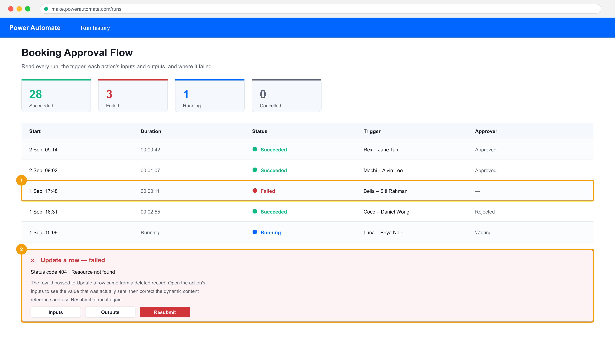
TOPIC 11 · TSC A5 · TESTING
Run History Is the Evidence
1
A failed run. Status and duration are the first signal something is wrong.
2
The failed action, its error, and Resubmit — the fix-and-retest loop.
This screen is your TSC A5/A6 evidence: it shows the connection between disparate programs, and whether it functioned.
TGS-2023036648 · Power Apps & Power Automate with Copilot
© 2026 Tertiary Infotech Academy Pte Ltd
109

Slide 110
12
TOPIC 12
Build Approval Flows with Power Automate
Approvals · outcome branching · business process flows · human in the loop
TGS-2023036648 · Power Apps & Power Automate with Copilot
© 2026 Tertiary Infotech Academy Pte Ltd
110

Slide 111
TOPIC 12 · CONCEPT
An Approval Pauses the Flow for a Person
1
2
3
4
5
Row created
Start and WAIT
Human decides
Condition
Update + notify
the business event
the flow suspends
approve or reject
branch on Outcome
the record and the requester
'START AND WAIT' IS THE POINT
The flow genuinely suspends — for minutes or days — and resumes on the human's answer. This is how you put a person where the consequence lands.
TGS-2023036648 · Power Apps & Power Automate with Copilot
© 2026 Tertiary Infotech Academy Pte Ltd
111

Slide 112
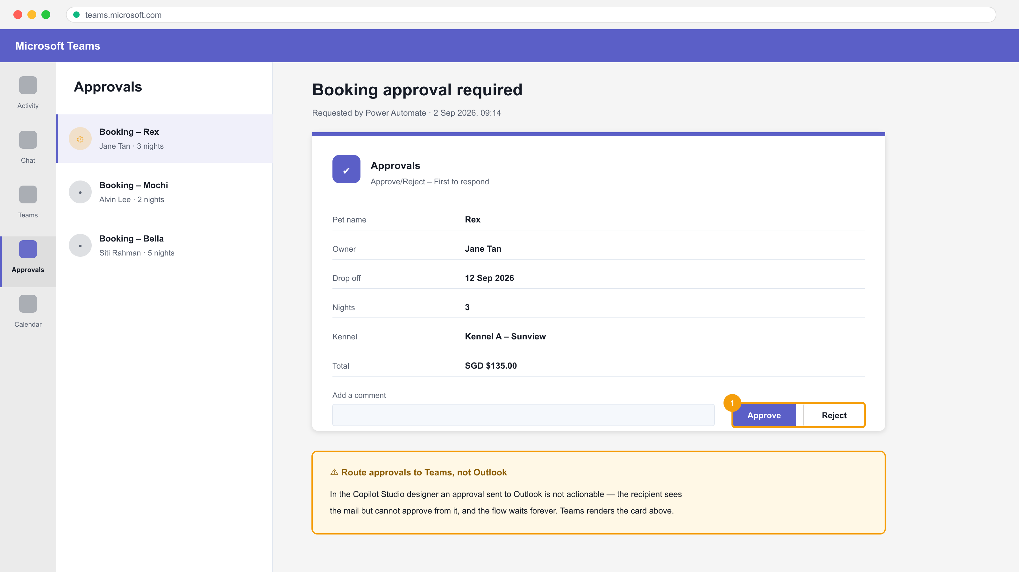
TOPIC 12 · HUMAN IN THE LOOP
The Approval Card — Route It to Teams
1
Approve and Reject are actionable IN the card. The flow resumes the moment one is pressed.
Verified on a live tenant: an approval sent to Outlook is not actionable in the Copilot Studio designer — the recipient can read it but cannot respond, and the flow waits forever. Send approvals to Teams.
TGS-2023036648 · Power Apps & Power Automate with Copilot
© 2026 Tertiary Infotech Academy Pte Ltd
112

Slide 113
TOPIC 12 · APPROVALS
Approval Types — Choose by How the Decision Is Made
Type
Who must respond
Outcome returned
Use when
Approve/Reject – First to respond
Any ONE of the assignees
Approve or Reject
Speed matters; any manager may decide
Approve/Reject – Everyone must approve
ALL assignees
Approve only if all approve
Spend or risk needs unanimous sign-off
Custom Responses – Wait for one
Any one assignee
Your own option text
The decision is not binary
Custom Responses – Wait for all
All assignees
All the responses
Multi-party sign-off with reasons
WHEN IT MATTERS The Outcome value is a STRING you compare in a Condition — 'Approve', not 'Approved'. Getting this wrong sends every request down the reject branch, and the flow still reports Succeeded.
TGS-2023036648 · Power Apps & Power Automate with Copilot
© 2026 Tertiary Infotech Academy Pte Ltd
113

Slide 114
13
TOPIC 13
Build Flows to Manage User Information
Trigger filters · user context · run-time input · calendar and location
TGS-2023036648 · Power Apps & Power Automate with Copilot
© 2026 Tertiary Infotech Academy Pte Ltd
114

Slide 115
TOPIC 13 · TSC A7 · EFFICIENCY
Trigger Filter or Condition — Where Should the Test Live?
NO — use a TRIGGER FILTER
Should the flow RUN
at all for this
change?
Select columns + Filter rows on the trigger. The flow never starts, so it costs nothing and the run history stays readable.
YES, but branch — use a CONDITION
The flow runs, then chooses a path. Every evaluation is a real run you will see in the history.
Lab 16 measures this: the same edits before and after filtering, with the run counts compared. Filters use the SCHEMA name (statuscode), never the display name.
TGS-2023036648 · Power Apps & Power Automate with Copilot
© 2026 Tertiary Infotech Academy Pte Ltd
115

Slide 116
TOPIC 13 · INPUTS
Getting the Right Values Into a Flow
Trigger inputs
Ask the person at run time — Text, Number, Date, File, Email.
Office 365 Users
Get my profile, Get manager — resolve the requester's chain of command.
1
2
Dynamic content
Any earlier step's output, inserted as a token.
Expressions
utcNow(), formatDateTime(), addDays() — for values nothing produced.
3
4
Variables
Initialize once, Set or Append inside a loop.
Parse JSON
Turn a JSON string into fields — but see structured output in Topic 14.
5
6
TGS-2023036648 · Power Apps & Power Automate with Copilot
© 2026 Tertiary Infotech Academy Pte Ltd
116

Slide 117
14
TOPIC 14
Power Automate, Copilot Studio Agents and Deep Integration
The new Copilot Studio · workflow vs agent · agent anatomy · tools · what is enforced
TGS-2023036648 · Power Apps & Power Automate with Copilot
© 2026 Tertiary Infotech Academy Pte Ltd
117

Slide 118
TOPIC 14 · CONCEPT
Workflow or Agent — They Fail Differently
WORKFLOW — Power Automate
AGENT — Copilot Studio
The path
You decide it in advance
It chooses at run time
Same input twice
Always the same output
May give a different answer
Capability
Only what you built
Can combine what it was given in new ways
How it fails
Loudly, at a named step
Quietly, with a confident wrong answer
How you test it
Check the result
Try to BREAK it
In this course
Labs 13–16
Labs 17–20
WHEN IT MATTERS Use a workflow where the rule is known. Use an agent where the language varies. Most real systems need both — and the seam between them is where the design work is.
TGS-2023036648 · Power Apps & Power Automate with Copilot
© 2026 Tertiary Infotech Academy Pte Ltd
118

Slide 119
TOPIC 14 · THE ARCHITECTURE
The New Copilot Studio — a Model Inside a Harness
The AI model — the brain
The reasoning engine. It understands language, spots patterns and decides what to do next. Chosen per agent from the Model dropdown — GPT-5.x or Claude.
1
The harness — around it
The orchestration layer the model works inside: context, tools, governance, workflows and security. Model-agnostic — it turns reasoning into governed work.
2
TGS-2023036648 · Power Apps & Power Automate with Copilot
© 2026 Tertiary Infotech Academy Pte Ltd
119

Slide 120
TOPIC 14 · AGENT ANATOMY
The Anatomy of an Agent — Five Parts
1
2
3
4
5
INSTRUCTIONS
SKILLS
KNOWLEDGE
TOOLS
CONNECTED AGENTS
who it is, always on
procedures on demand
documents it may read
flows it can call
hand off to a specialist
BUILT IN LABS 17–20
Lab 17 builds instructions and knowledge. Lab 18 adds a tool. Lab 19 puts an Agent node inside a flow. Lab 20 adds a connected agent and a human gate.
TGS-2023036648 · Power Apps & Power Automate with Copilot
© 2026 Tertiary Infotech Academy Pte Ltd
120

Slide 121
TOPIC 14 · THE SPINE OF LAB 17
Which Parts of an Agent Hold — and Which Do Not
Part
What it is
Enforced?
Instructions
Who the agent is; always in force
NO — probabilistic
Skill
A named procedure for a matching topic
NO — the model decides it applies
Knowledge
Documents the agent may read
PARTLY — it cannot read what it lacks
Tool (agent flow)
A flow that acts outside the conversation
YES — the flow's own logic runs
Connected agent
A separate agent with its own knowledge
YES — the knowledge boundary is real
WHEN IT MATTERS A control the model cannot reach beats a rule you asked it to follow. So: a tool the agent does NOT have is a control — and the schema beats the prompt, because a field that exists will eventually be filled.
TGS-2023036648 · Power Apps & Power Automate with Copilot
© 2026 Tertiary Infotech Academy Pte Ltd
121

Slide 122
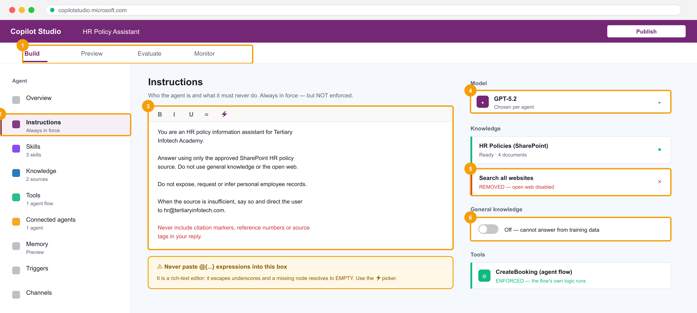
TOPIC 14 · THE INTERFACE
The New Agent Designer — Everything on One Rail
1
Four tabs: Build, Preview, Evaluate, Monitor — author, probe, score, then watch it live.
2
Instructions, Skills, Knowledge, Tools, Connected agents and Memory, all on one rail.
3
The instructions box is a RICH-TEXT editor. Never paste @{...} into it.
4
The model is chosen per agent; the harness stays the same.
5
'Search all websites' is ON by default. Remove it, or open-web facts reach your user.
6
Turn general knowledge OFF, or the model answers from training data and you cannot tell which answers those were.
Grounding is not only about giving the agent facts. It is about taking away every other source of them. Built in Lab 17.
TGS-2023036648 · Power Apps & Power Automate with Copilot
© 2026 Tertiary Infotech Academy Pte Ltd
122

Slide 123
TOPIC 14 · INSTRUCTIONS
Writing Instructions That Constrain
1 · Identity
"You are an HR policy information assistant." One role, one line.
2 · Source rule
"Answer using only the approved SharePoint HR policy source."
1
2
3 · Refusals
"Do not expose, request or infer personal employee records." Prohibitions, not preferences.
4 · Escalation
"When the source is insufficient, say so and direct the user to HR."
3
4
5 · No citation markers
Grounding appends [doc:turn1doc11] and [1] tags the model did not write. Ban them explicitly.
6 · Build with the ⚡ picker
The editor escapes underscores, and a missing node resolves to EMPTY rather than erroring.
5
6
TGS-2023036648 · Power Apps & Power Automate with Copilot
© 2026 Tertiary Infotech Academy Pte Ltd
123

Slide 124
TOPIC 14 · TOOLS
Tools — Where the Agent Stops and the Flow Starts
1
2
3
4
5
User asks
Agent decides
Flow runs
Respond to the agent
Answer in chat
in natural language
a tool applies · PROBABILISTIC
validate, write, notify · ENFORCED
the typed result
what the user sees
THE SEAM IS THE DESIGN
The agent may call the wrong tool, or the right one with wrong values. Whatever it believed, the flow's own validation still runs. Put the consequence inside the flow — Lab 18.
TGS-2023036648 · Power Apps & Power Automate with Copilot
© 2026 Tertiary Infotech Academy Pte Ltd
124

Slide 125
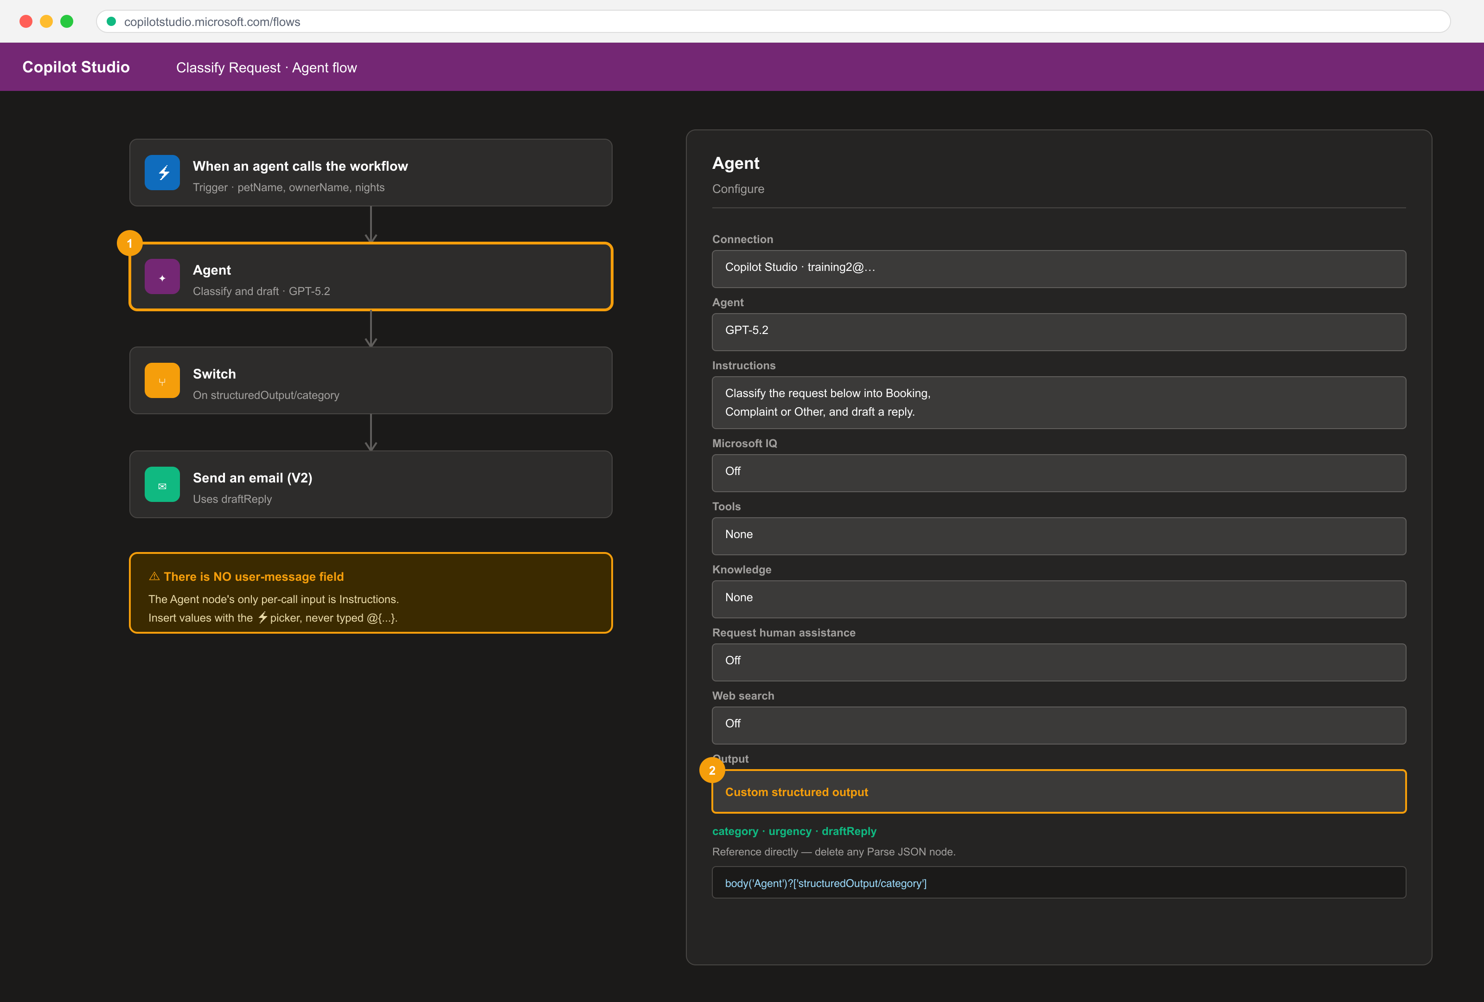
TOPIC 14 · CALLING AN AGENT FROM A FLOW
The Agent Node Inside a Flow — and Structured Output
1
The Agent node. Its Configure tab has NO user-message field — Instructions is the only per-call input.
2
Output › Custom structured output. Define the schema, then reference fields directly and DELETE any Parse JSON node.
With Text response you are asking the model for JSON and hoping. With Custom structured output the fields are typed — body('Agent')?['structuredOutput/category']. Built in Lab 19.
TGS-2023036648 · Power Apps & Power Automate with Copilot
© 2026 Tertiary Infotech Academy Pte Ltd
125

Slide 126
TOPIC 14 · DESIGN DECISION
Structured Output or Parse JSON?
YES — Custom structured output
Does anything
DOWNSTREAM need
individual FIELDS from
the agent's answer?
Define the schema on the Agent node. Reference fields with the slash syntax. Delete the Parse JSON node entirely.
NO — Text response is fine
The answer goes straight into an email body or a chat reply. Nothing branches on it.
With Text response the model will eventually wrap its answer in ```json fences or open with 'Here is the JSON', and Parse JSON fails with "Error parsing NaN value. Path '', line 1, position 1" — position 1 means the first character was not {.
TGS-2023036648 · Power Apps & Power Automate with Copilot
© 2026 Tertiary Infotech Academy Pte Ltd
126

Slide 127
WHAT YOU'LL DO
Hands-On Labs — Create and Manage Automated Processes with Power Automate and Copilot Studio Agents
Labs 13–15
Labs 16–18
Labs 19–20
• Create Cloud Flows — Template, Copilot and Blank
• Build an Approval Flow with a Human in the Loop
• Button Flows and Scheduled Flows
• Trigger Filters and Cross-Source Integration
• Build Your First Copilot Studio Agent
• Give the Agent a Tool — Calling a Workflow from an Agent
• Call an Agent from a Workflow with Structured Output
• Multi-Agent Handoff and a Human Review Gate
TGS-2023036648 · Power Apps & Power Automate with Copilot
© 2026 Tertiary Infotech Academy Pte Ltd
127

Slide 128
LU3 · HANDS-ON
Create Cloud Flows — Template, Copilot and Blank
LAB 13
A3/A5 — Build flows three ways and verify each run against its trigger and actions.
Create one flow from a template, one with Copilot and one from blank, so the trigger-actions-outputs anatomy is visible from three directions, then read the run history of each.
YOU'LL BUILD
TOOLCHAIN
DONE WHEN
Three working cloud flows plus a read of their run history.
Power Automate, Outlook, SharePoint, Copilot for Power Automate
All three flows show a Succeeded run, and you can name the trigger and each action's output that supplied a value in the email.
TGS-2023036648 · Power Apps & Power Automate with Copilot
© 2026 Tertiary Infotech Academy Pte Ltd
128

Slide 129
LAB 13 · PROCESS MAP
How Lab 13 Runs
1
2
3
4
5
From a template
With Copilot
From blank
Dynamic content
Compare run histories
and run it
from a description
choose the trigger
insert, never type
all three flows
THE POINT
A3/A5 — Build flows three ways and verify each run against its trigger and actions.
TGS-2023036648 · Power Apps & Power Automate with Copilot
© 2026 Tertiary Infotech Academy Pte Ltd
129

Slide 130
LAB 13 · VERIFY
Create Cloud Flows — Template, Copilot and Blank
✅ Expected result
All three flows show a Succeeded run, and you can name the trigger and each action's output that supplied a value in the email.
IF IT DOESN'T WORK
Nothing appears
Permission or 403 error
Step-by-step needed
Confirm you are in the environment the trainer named — apps, flows and agents must share one.
Sharing an app does not share its data. Check the Dataverse security role.
Every numbered step, with the exact click path, is in the Learner Guide and labs/lab-13/README.md.
TGS-2023036648 · Power Apps & Power Automate with Copilot
© 2026 Tertiary Infotech Academy Pte Ltd
130

Slide 131
LU3 · HANDS-ON
Build an Approval Flow with a Human in the Loop
LAB 14
A3/A5 — Pause an automated process for a human decision and branch on the outcome.
Build a flow that starts when a booking request row is created, sends an approval to a manager, waits for the response, and updates the record's status based on the outcome.
YOU'LL BUILD
TOOLCHAIN
DONE WHEN
An approval flow that writes Confirmed or Declined back to Dataverse based on a human decision.
Power Automate, Approvals, Dataverse, Outlook, Microsoft Teams
Approving the request sets the Dataverse row's Status to Confirmed and the requester receives the notification email; rejecting sets Declined.
TGS-2023036648 · Power Apps & Power Automate with Copilot
© 2026 Tertiary Infotech Academy Pte Ltd
131

Slide 132
LAB 14 · PROCESS MAP
How Lab 14 Runs
1
2
3
4
5
Automated trigger
Send for approval
Human decides
Condition on Outcome
Update and notify
a row is added
the flow suspends
in Teams
branch the run
status and email
THE POINT
A3/A5 — Pause an automated process for a human decision and branch on the outcome.
TGS-2023036648 · Power Apps & Power Automate with Copilot
© 2026 Tertiary Infotech Academy Pte Ltd
132

Slide 133
LAB 14 · VERIFY
Build an Approval Flow with a Human in the Loop
✅ Expected result
Approving the request sets the Dataverse row's Status to Confirmed and the requester receives the notification email; rejecting sets Declined.
IF IT DOESN'T WORK
Nothing appears
Permission or 403 error
Step-by-step needed
Confirm you are in the environment the trainer named — apps, flows and agents must share one.
Sharing an app does not share its data. Check the Dataverse security role.
Every numbered step, with the exact click path, is in the Learner Guide and labs/lab-14/README.md.
TGS-2023036648 · Power Apps & Power Automate with Copilot
© 2026 Tertiary Infotech Academy Pte Ltd
133

Slide 134
LU3 · HANDS-ON
Button Flows and Scheduled Flows
LAB 15
A3 — Use manual and scheduled triggers, and collect user input at run time.
Build an instant (button) flow that prompts the user for input and creates a record, then build a scheduled flow that queries rows on a recurrence and emails an HTML summary table.
YOU'LL BUILD
TOOLCHAIN
DONE WHEN
An instant flow with user input and a recurring digest flow that emails a formatted table.
Power Automate, Dataverse, Outlook
The button flow creates a Dataverse row from the values you typed, and the scheduled flow's test run emails a formatted HTML table of pending bookings.
TGS-2023036648 · Power Apps & Power Automate with Copilot
© 2026 Tertiary Infotech Academy Pte Ltd
134

Slide 135
LAB 15 · PROCESS MAP
How Lab 15 Runs
1
2
3
4
5
Instant trigger
Collect user input
Write the row
Recurrence
Query and email
a person presses Run
three parameters
to Dataverse
set the time zone
an HTML table
THE POINT
A3 — Use manual and scheduled triggers, and collect user input at run time.
TGS-2023036648 · Power Apps & Power Automate with Copilot
© 2026 Tertiary Infotech Academy Pte Ltd
135

Slide 136
LAB 15 · VERIFY
Button Flows and Scheduled Flows
✅ Expected result
The button flow creates a Dataverse row from the values you typed, and the scheduled flow's test run emails a formatted HTML table of pending bookings.
IF IT DOESN'T WORK
Nothing appears
Permission or 403 error
Step-by-step needed
Confirm you are in the environment the trainer named — apps, flows and agents must share one.
Sharing an app does not share its data. Check the Dataverse security role.
Every numbered step, with the exact click path, is in the Learner Guide and labs/lab-15/README.md.
TGS-2023036648 · Power Apps & Power Automate with Copilot
© 2026 Tertiary Infotech Academy Pte Ltd
136

Slide 137
LU3 · HANDS-ON
Trigger Filters and Cross-Source Integration
LAB 16
A5/A7 — Stop unnecessary runs with trigger filters and highlight performance issues.
Add column and row filters to an automated trigger so the flow only runs when it must, then integrate SharePoint, Dataverse and Excel in one flow and compare run counts before and after filtering.
YOU'LL BUILD
TOOLCHAIN
DONE WHEN
A filtered automated flow plus a run-count comparison showing the performance improvement.
Power Automate, Dataverse, SharePoint, Excel Online (Business)
After filtering, edits to non-Status columns produce no runs, and a single Confirmed change writes to all three data sources in one Succeeded run.
TGS-2023036648 · Power Apps & Power Automate with Copilot
© 2026 Tertiary Infotech Academy Pte Ltd
137

Slide 138
LAB 16 · PROCESS MAP
How Lab 16 Runs
1
2
3
4
5
Find the schema name
Baseline the runs
Select columns
Filter rows
Write to three sources
not the display name
before filtering
only Status fires it
only Confirmed
one business event
THE POINT
A5/A7 — Stop unnecessary runs with trigger filters and highlight performance issues.
TGS-2023036648 · Power Apps & Power Automate with Copilot
© 2026 Tertiary Infotech Academy Pte Ltd
138

Slide 139
LAB 16 · VERIFY
Trigger Filters and Cross-Source Integration
✅ Expected result
After filtering, edits to non-Status columns produce no runs, and a single Confirmed change writes to all three data sources in one Succeeded run.
IF IT DOESN'T WORK
Nothing appears
Permission or 403 error
Step-by-step needed
Confirm you are in the environment the trainer named — apps, flows and agents must share one.
Sharing an app does not share its data. Check the Dataverse security role.
Every numbered step, with the exact click path, is in the Learner Guide and labs/lab-16/README.md.
TGS-2023036648 · Power Apps & Power Automate with Copilot
© 2026 Tertiary Infotech Academy Pte Ltd
139

Slide 140
LU3 · HANDS-ON
Build Your First Copilot Studio Agent
LAB 17
A1/A3 — Build a conversational agent with instructions and knowledge as a new integration surface.
In the new Copilot Studio agent designer, create an agent, choose its model, write constraining instructions, attach a SharePoint knowledge source and remove every other source of facts, then probe it for hallucination.
YOU'LL BUILD
TOOLCHAIN
DONE WHEN
A grounded Copilot Studio agent that answers only from your documents and refuses otherwise.
Copilot Studio (new agent designer), SharePoint, Dataverse
The agent answers the in-scope questions from the documents and explicitly declines the out-of-scope ones instead of inventing an answer.
TGS-2023036648 · Power Apps & Power Automate with Copilot
© 2026 Tertiary Infotech Academy Pte Ltd
140

Slide 141
LAB 17 · PROCESS MAP
How Lab 17 Runs
1
2
3
4
5
Create the agent
Write instructions
Attach knowledge
Remove other sources
Probe it
name and model
identity and refusals
wait for Ready
web and general
try to make it invent
THE POINT
A1/A3 — Build a conversational agent with instructions and knowledge as a new integration surface.
TGS-2023036648 · Power Apps & Power Automate with Copilot
© 2026 Tertiary Infotech Academy Pte Ltd
141

Slide 142
LAB 17 · VERIFY
Build Your First Copilot Studio Agent
✅ Expected result
The agent answers the in-scope questions from the documents and explicitly declines the out-of-scope ones instead of inventing an answer.
IF IT DOESN'T WORK
Nothing appears
Permission or 403 error
Step-by-step needed
Confirm you are in the environment the trainer named — apps, flows and agents must share one.
Sharing an app does not share its data. Check the Dataverse security role.
Every numbered step, with the exact click path, is in the Learner Guide and labs/lab-17/README.md.
TGS-2023036648 · Power Apps & Power Automate with Copilot
© 2026 Tertiary Infotech Academy Pte Ltd
142

Slide 143
LU3 · HANDS-ON
Give the Agent a Tool — Calling a Workflow from an Agent
LAB 18
A4 — Expose a deterministic flow to an agent as a callable tool with typed inputs and outputs.
Build an agent flow that validates and writes a booking, then register it as a tool on the agent so the conversation can act on the outside world while the enforced logic stays in the flow.
YOU'LL BUILD
TOOLCHAIN
DONE WHEN
An agent that calls a Power Automate flow as a tool and returns the flow's result in chat.
Copilot Studio agent flows, Power Automate, Dataverse, Microsoft Teams
A valid request creates a Dataverse row and returns the confirmation in chat; the 60-night request is refused by the flow's own Condition.
TGS-2023036648 · Power Apps & Power Automate with Copilot
© 2026 Tertiary Infotech Academy Pte Ltd
143

Slide 144
LAB 18 · PROCESS MAP
How Lab 18 Runs
1
2
3
4
5
New agent flow
Typed inputs
Validate
Write and respond
Probe the boundary
the tool
from the conversation
enforced, unlike a prompt
back to the agent
the flow refuses
THE POINT
A4 — Expose a deterministic flow to an agent as a callable tool with typed inputs and outputs.
TGS-2023036648 · Power Apps & Power Automate with Copilot
© 2026 Tertiary Infotech Academy Pte Ltd
144

Slide 145
LAB 18 · VERIFY
Give the Agent a Tool — Calling a Workflow from an Agent
✅ Expected result
A valid request creates a Dataverse row and returns the confirmation in chat; the 60-night request is refused by the flow's own Condition.
IF IT DOESN'T WORK
Nothing appears
Permission or 403 error
Step-by-step needed
Confirm you are in the environment the trainer named — apps, flows and agents must share one.
Sharing an app does not share its data. Check the Dataverse security role.
Every numbered step, with the exact click path, is in the Learner Guide and labs/lab-18/README.md.
TGS-2023036648 · Power Apps & Power Automate with Copilot
© 2026 Tertiary Infotech Academy Pte Ltd
145

Slide 146
LU3 · HANDS-ON
Call an Agent from a Workflow with Structured Output
LAB 19
A4/A5 — Use an Agent node inside a flow and consume its typed fields downstream.
Build a Power Automate flow containing an Agent node that classifies an incoming request, configure Custom structured output so the result is typed JSON, and branch the flow on the returned fields.
YOU'LL BUILD
TOOLCHAIN
DONE WHEN
A flow whose Agent node returns structured JSON that the following actions branch on.
Copilot Studio workflow designer, Agent node, Dataverse, Outlook
The Agent node's Run Details shows the three schema fields populated, and the Switch routes the run to the case matching the returned category.
TGS-2023036648 · Power Apps & Power Automate with Copilot
© 2026 Tertiary Infotech Academy Pte Ltd
146

Slide 147
LAB 19 · PROCESS MAP
How Lab 19 Runs
1
2
3
4
5
Add an Agent node
Instructions only
Structured output
Delete Parse JSON
Switch on a field
inside the flow
no message field
define the schema
reference fields
route the run
THE POINT
A4/A5 — Use an Agent node inside a flow and consume its typed fields downstream.
TGS-2023036648 · Power Apps & Power Automate with Copilot
© 2026 Tertiary Infotech Academy Pte Ltd
147

Slide 148
LAB 19 · VERIFY
Call an Agent from a Workflow with Structured Output
✅ Expected result
The Agent node's Run Details shows the three schema fields populated, and the Switch routes the run to the case matching the returned category.
IF IT DOESN'T WORK
Nothing appears
Permission or 403 error
Step-by-step needed
Confirm you are in the environment the trainer named — apps, flows and agents must share one.
Sharing an app does not share its data. Check the Dataverse security role.
Every numbered step, with the exact click path, is in the Learner Guide and labs/lab-19/README.md.
TGS-2023036648 · Power Apps & Power Automate with Copilot
© 2026 Tertiary Infotech Academy Pte Ltd
148

Slide 149
LU3 · HANDS-ON
Multi-Agent Handoff and a Human Review Gate
LAB 20
A5/A7 — Compose connected agents and place a human where the consequence lands.
Connect a second specialist agent so one conversation can hand off to another with its own knowledge, then add a Request human assistance gate so a consequential action cannot proceed without approval.
YOU'LL BUILD
TOOLCHAIN
DONE WHEN
A two-agent system with a working handoff and a human review gate that blocks the run.
Copilot Studio (connected agents), agent flows, Microsoft Teams approvals
The claims question is answered by the connected agent, and a rejected booking leaves no Dataverse row while an approved one does.
TGS-2023036648 · Power Apps & Power Automate with Copilot
© 2026 Tertiary Infotech Academy Pte Ltd
149

Slide 150
LAB 20 · PROCESS MAP
How Lab 20 Runs
1
2
3
4
5
Second agent
Connect it
Test the handoff
Human review gate
Reject then approve
its own knowledge
describe the handoff
two question types
route to Teams
compare the runs
THE POINT
A5/A7 — Compose connected agents and place a human where the consequence lands.
TGS-2023036648 · Power Apps & Power Automate with Copilot
© 2026 Tertiary Infotech Academy Pte Ltd
150

Slide 151
LAB 20 · VERIFY
Multi-Agent Handoff and a Human Review Gate
✅ Expected result
The claims question is answered by the connected agent, and a rejected booking leaves no Dataverse row while an approved one does.
IF IT DOESN'T WORK
Nothing appears
Permission or 403 error
Step-by-step needed
Confirm you are in the environment the trainer named — apps, flows and agents must share one.
Sharing an app does not share its data. Check the Dataverse security role.
Every numbered step, with the exact click path, is in the Learner Guide and labs/lab-20/README.md.
TGS-2023036648 · Power Apps & Power Automate with Copilot
© 2026 Tertiary Infotech Academy Pte Ltd
151

Slide 152
LEARNING UNIT RECAP · YOU CAN NOW
Recap — Create and Manage Automated Processes with Power Automate and Copilot Studio Agents (1/2)
Lab 13 — Create Cloud Flows — Template, Copilot and Blank
A3/A5 — Build flows three ways and verify each run against its trigger and actions.
Lab 14 — Build an Approval Flow with a Human in the Loop
A3/A5 — Pause an automated process for a human decision and branch on the outcome.
1
2
Lab 15 — Button Flows and Scheduled Flows
A3 — Use manual and scheduled triggers, and collect user input at run time.
Lab 16 — Trigger Filters and Cross-Source Integration
A5/A7 — Stop unnecessary runs with trigger filters and highlight performance issues.
3
4
TGS-2023036648 · Power Apps & Power Automate with Copilot
© 2026 Tertiary Infotech Academy Pte Ltd
152

Slide 153
LEARNING UNIT RECAP · YOU CAN NOW
Recap — Create and Manage Automated Processes with Power Automate and Copilot Studio Agents (2/2)
Lab 17 — Build Your First Copilot Studio Agent
A1/A3 — Build a conversational agent with instructions and knowledge as a new integration surface.
Lab 18 — Give the Agent a Tool — Calling a Workflow from an Agent
A4 — Expose a deterministic flow to an agent as a callable tool with typed inputs and outputs.
1
2
Lab 19 — Call an Agent from a Workflow with Structured Output
A4/A5 — Use an Agent node inside a flow and consume its typed fields downstream.
Lab 20 — Multi-Agent Handoff and a Human Review Gate
A5/A7 — Compose connected agents and place a human where the consequence lands.
3
4
TGS-2023036648 · Power Apps & Power Automate with Copilot
© 2026 Tertiary Infotech Academy Pte Ltd
153

Slide 154
4
LU4
Model-Driven Apps with Power Apps and Dataverse
Topics 15–19 · Labs 21–26
TGS-2023036648 · Power Apps & Power Automate with Copilot
© 2026 Tertiary Infotech Academy Pte Ltd
154

Slide 155
15
TOPIC 15
Create Tables in Dataverse
Table characteristics · properties · columns · relationships · keys
TGS-2023036648 · Power Apps & Power Automate with Copilot
© 2026 Tertiary Infotech Academy Pte Ltd
155

Slide 156
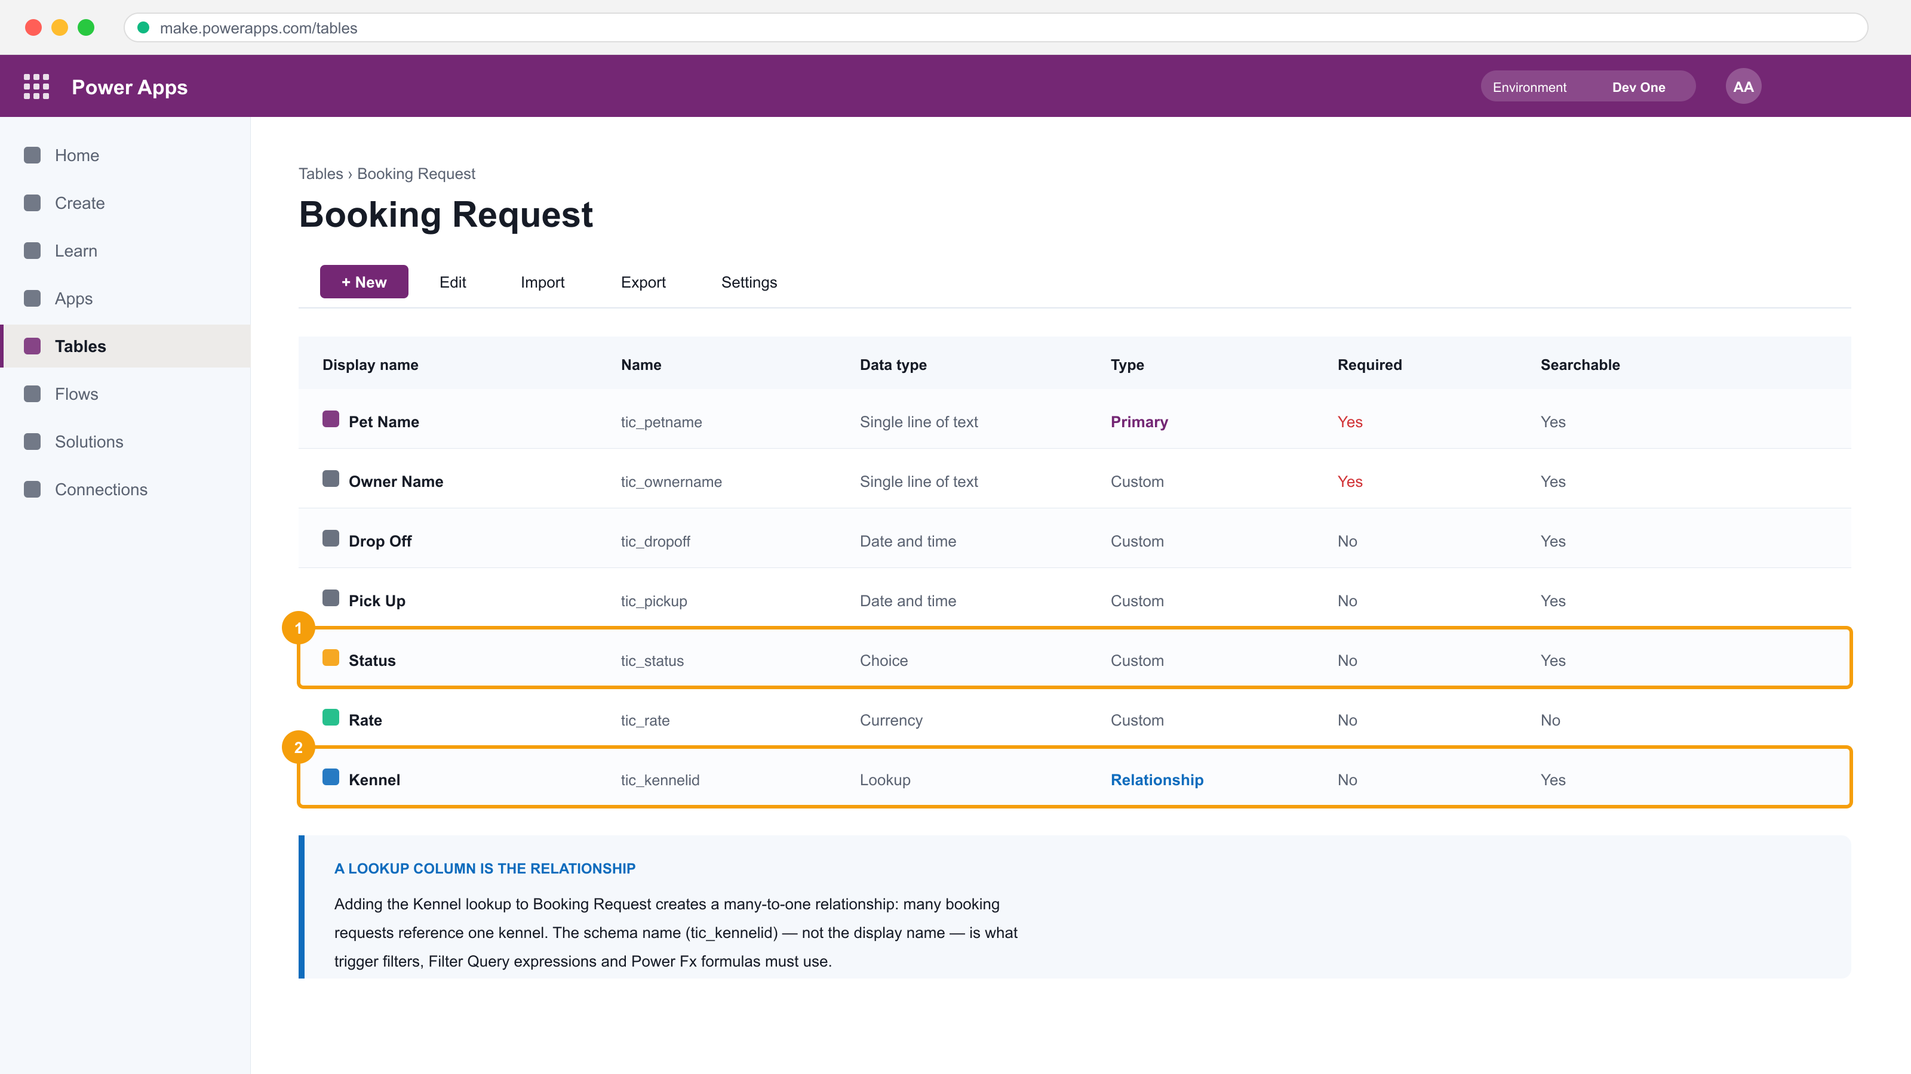
TOPIC 15 · THE INTERFACE
A Dataverse Table Is More Than Rows and Columns
1
A Choice column stores a value from a defined option set — in a formula it is Status.Value.
2
A Lookup column IS the relationship. Adding it creates a many-to-one link to the other table.
Note the Name column: tic_kennelid. That schema name — not the display name — is what trigger filters, Filter Query expressions and Power Fx must use.
TGS-2023036648 · Power Apps & Power Automate with Copilot
© 2026 Tertiary Infotech Academy Pte Ltd
156

Slide 157
TOPIC 15 · TABLE ANATOMY
The Parts of a Dataverse Table
Rows
Individual records — one booking, one property, one pet.
Columns
The metadata on each record, each with a data type.
1
2
Relationships
Connections between tables — one-to-many, many-to-one, many-to-many.
Keys
Unique identifiers; the primary key is a GUID the platform generates.
3
4
Primary column
The single text column that names the row across the product.
Views & forms
Saved queries and layouts that belong to the table itself.
5
6
TGS-2023036648 · Power Apps & Power Automate with Copilot
© 2026 Tertiary Infotech Academy Pte Ltd
157

Slide 158
TOPIC 15 · DATA TYPES
Choosing the Right Column Data Type
Data type
Stores
Watch out for
Single line of text
Short text up to 4,000 characters
Not for anything you will do maths on
Choice
One value from a defined option set
In formulas it is Status.Value, not Status
Lookup
A reference to a row in another table
This IS the relationship — it cannot be added later for free
Currency
Money, with a currency and exchange rate
Creates a hidden base-currency column too
Date and time / Date only
A moment, or a calendar date
Time-zone behaviour differs between the two
Whole number / Decimal
Counts and measurements
Decimal for money is a trap — use Currency
WHEN IT MATTERS Changing a column's data type after rows exist is often impossible — you create a new column and migrate. Model deliberately in Lab 21 before you build the app in Lab 22.
TGS-2023036648 · Power Apps & Power Automate with Copilot
© 2026 Tertiary Infotech Academy Pte Ltd
158

Slide 159
16
TOPIC 16
Get Started with Model-Driven Apps in Power Apps
Components · the app designer · site map · running the app
TGS-2023036648 · Power Apps & Power Automate with Copilot
© 2026 Tertiary Infotech Academy Pte Ltd
159

Slide 160
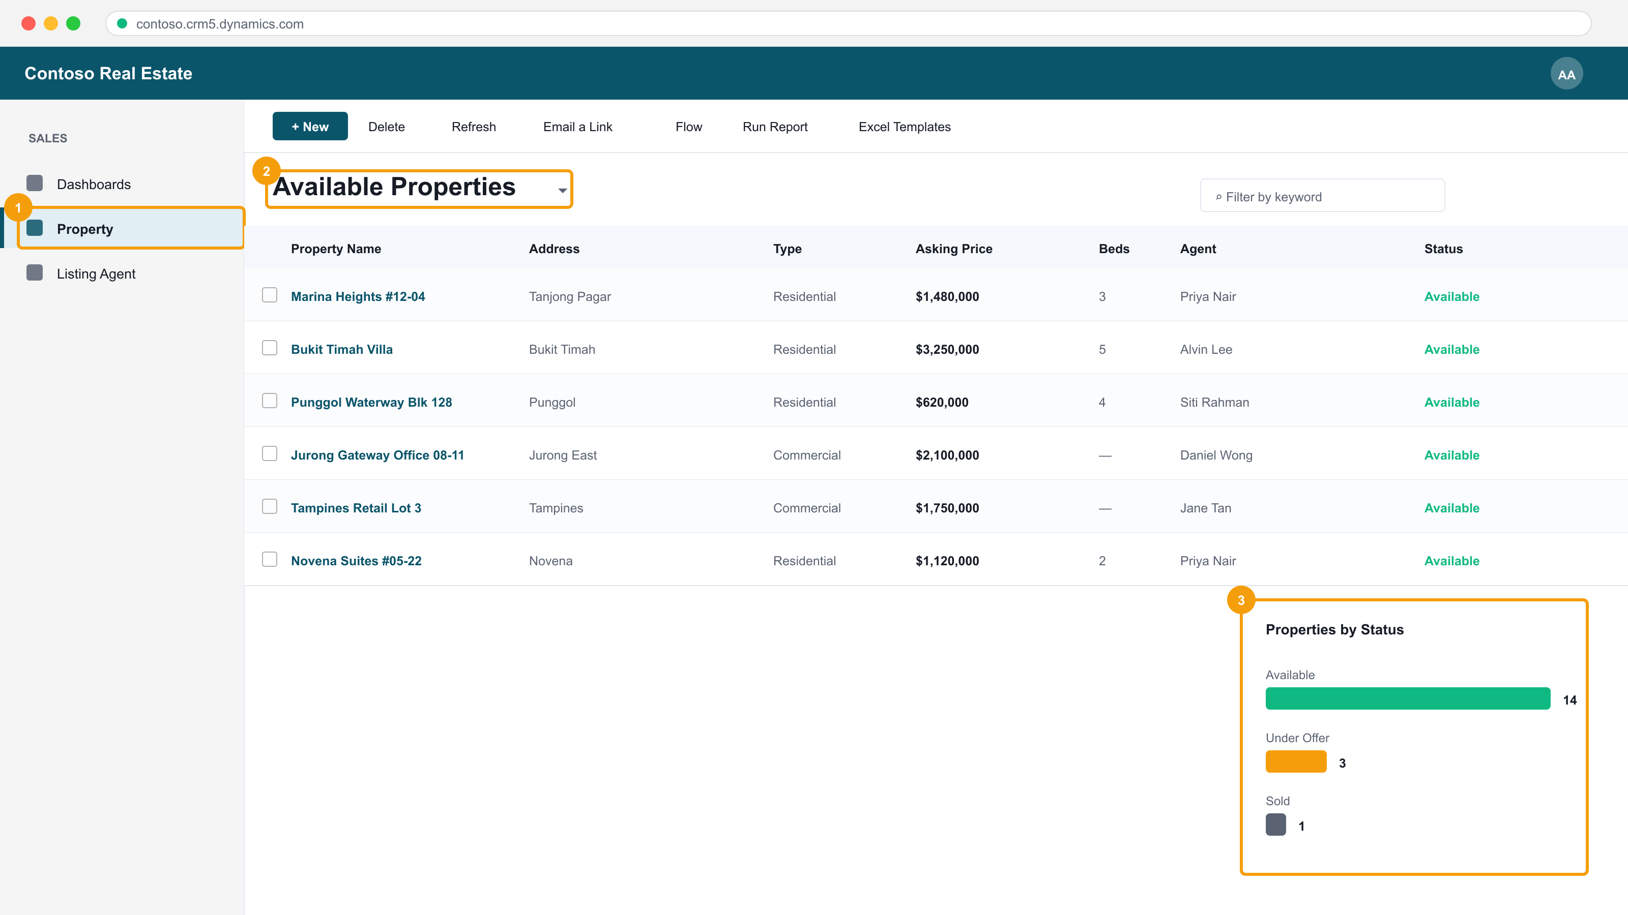
TOPIC 16 · THE INTERFACE
A Model-Driven App Is Generated from the Data Model
1
The site map — the navigation you configure from the tables in the app.
2
The view selector. Views are saved queries that belong to the table.
3
A chart, driven by the same Dataverse rows, with no code.
You did not draw this screen. You chose the tables, and the platform generated the grid, the forms, the commands and the search. Built in Labs 21–24.
TGS-2023036648 · Power Apps & Power Automate with Copilot
© 2026 Tertiary Infotech Academy Pte Ltd
160

Slide 161
TOPIC 16 · THE SEQUENCE
Building a Model-Driven App
1
2
3
4
5
Model the data
Add pages
Configure navigation
Publish
Play
tables, columns, relationships
table view + form
the site map
make it live
run it as a user
THE DATA MODEL COMES FIRST
In a canvas app you can design the screen before you know the data. In a model-driven app you cannot — the app IS the data model, surfaced.
TGS-2023036648 · Power Apps & Power Automate with Copilot
© 2026 Tertiary Infotech Academy Pte Ltd
161

Slide 162
17
TOPIC 17
Configure Forms, Charts and Dashboards
Form types · form elements · views · charts · dashboards
TGS-2023036648 · Power Apps & Power Automate with Copilot
© 2026 Tertiary Infotech Academy Pte Ltd
162

Slide 163
TOPIC 17 · FORMS
The Four Form Types
Form type
Where it appears
Shows
Main
The record's own page
The full record, in tabs and sections
Quick View
Embedded in ANOTHER record's form
Read-only fields from a related row
Quick Create
A fly-out from + New
A short form for fast data entry
Card
In a view on a mobile layout
A few fields, compactly
WHEN IT MATTERS The Quick View form is how the Property record shows its agent's phone and email without the user navigating away — configured in Lab 23.
TGS-2023036648 · Power Apps & Power Automate with Copilot
© 2026 Tertiary Infotech Academy Pte Ltd
163

Slide 164
TOPIC 17 · VISUALISATION
Views, Charts and Dashboards
Public view
A saved query everyone can select — filter, sort and columns.
Personal view
A user's own saved query, visible only to them.
1
2
Chart
A visualisation over one table, respecting the current view's filter.
Dashboard
Charts plus lists on one page, cross-filtering each other.
3
4
Security trimmed
Every view, chart and dashboard shows only rows the user may read.
No code
All of it is configuration — this is the model-driven trade.
5
6
TGS-2023036648 · Power Apps & Power Automate with Copilot
© 2026 Tertiary Infotech Academy Pte Ltd
164

Slide 165
TOPIC 17 · CHARTS
What a Dataverse Chart Renders — Properties by Status
WHAT THE DATA SHOWS
These are the real counts from the 18 rows in Lab 21's properties.csv. The chart is a saved definition over the table, not a copy of the data — verify against expected-chart-values.csv in Lab 24.
TGS-2023036648 · Power Apps & Power Automate with Copilot
© 2026 Tertiary Infotech Academy Pte Ltd
165

Slide 166
TOPIC 17 · CHARTS
Average Asking Price by Property Type (SGD)
WHAT THE DATA SHOWS
Computed from the same 18 rows: 12 residential averaging SGD 2,569,583 and 6 commercial averaging SGD 4,255,000. An aggregate chart computes server-side across every row the USER may see — so two users can open the same chart and correctly see different numbers.
TGS-2023036648 · Power Apps & Power Automate with Copilot
© 2026 Tertiary Infotech Academy Pte Ltd
166

Slide 167
18
TOPIC 18
Manage Solutions in Power Apps and Power Automate
Solutions · publishers · managed vs unmanaged · environments · ALM
TGS-2023036648 · Power Apps & Power Automate with Copilot
© 2026 Tertiary Infotech Academy Pte Ltd
167

Slide 168
TOPIC 18 · TSC A8 · ALM
How a Change Reaches Production
1
2
3
4
5
Build in DEV
Add components
Export MANAGED
Import to TEST
Promote to PROD
unmanaged solution
apps, flows, tables
a versioned .zip
supply connections
the same package
THIS IS TSC A8
Implementing modifications to middleware safely means shipping them as a versioned, reviewable package — not editing production by hand.
TGS-2023036648 · Power Apps & Power Automate with Copilot
© 2026 Tertiary Infotech Academy Pte Ltd
168

Slide 169
TOPIC 18 · SOLUTIONS
Managed or Unmanaged — The Decision That Cannot Be Undone
Unmanaged
Managed
Purpose
Development
Distribution
Can components be edited?
Yes
No — locked in the target
Uninstall
Leaves components behind
Removes its components cleanly
Where it belongs
Your DEV environment
TEST and PRODUCTION
Reversible?
—
You cannot convert managed back to unmanaged
WHEN IT MATTERS Importing an unmanaged solution into production is the mistake that cannot be cleanly undone. Develop unmanaged, ship managed — Lab 25.
TGS-2023036648 · Power Apps & Power Automate with Copilot
© 2026 Tertiary Infotech Academy Pte Ltd
169

Slide 170
TOPIC 18 · PACKAGING
What Belongs in the Solution
Tables and columns
The data model your app depends on.
Apps
Canvas and model-driven apps alike.
1
2
Flows
Ship the automation WITH the app that relies on it.
Forms, views, charts, dashboards
They belong to their tables.
3
4
Connection references
So the target environment can rebind its own connections.
Environment variables
Values that legitimately differ per environment.
5
6
TGS-2023036648 · Power Apps & Power Automate with Copilot
© 2026 Tertiary Infotech Academy Pte Ltd
170

Slide 171
19
TOPIC 19
Guided Project & Troubleshooting Power Platform Integrations
Contoso Real Estate · isolating the failing layer · TSC A7 and A8
TGS-2023036648 · Power Apps & Power Automate with Copilot
© 2026 Tertiary Infotech Academy Pte Ltd
171

Slide 172
TOPIC 19 · TSC A7 · DIAGNOSIS
Troubleshooting — Isolate the Layer Before You Change Anything
Loads for others → it is PERMISSION or ENVIRONMENT
Does the SAME data
load for a different
USER, in a different
ENVIRONMENT?
Check the security role, the connection reference, and which environment the app or flow actually points at.
Fails for everyone → it is the FORMULA, the CONNECTOR or the DATA
Check delegation, the connector's status and licence, and whether the rows genuinely match the filter.
Lab 26 seeds four faults — a delegation warning, a failed flow action, a permission error and a broken connection reference — and you record layer, evidence and fix for each in troubleshooting-log.csv.
TGS-2023036648 · Power Apps & Power Automate with Copilot
© 2026 Tertiary Infotech Academy Pte Ltd
172

Slide 173
TOPIC 19 · TSC A7
Reading the Error — What Each Symptom Actually Means
Symptom
Layer
First thing to check
Blue delegation warning
Formula
A non-delegable function — rewrite it, don't raise the row limit
403 / 'permission'
Security
The user's Dataverse security role, not the app share
404 / 'not found'
Data
The record id you passed — read the action's Inputs
429 / throttled
Performance
Trigger filters and loop concurrency — you are running too often
Flow never triggers
Trigger
Column/row filters, the scope, and the environment
Agent answers wrongly
Grounding
General knowledge on, or 'Search all websites' still attached
WHEN IT MATTERS Every one of these appears in Lab 26. The discipline is the same each time: name the layer, capture the evidence, apply one change, re-test.
TGS-2023036648 · Power Apps & Power Automate with Copilot
© 2026 Tertiary Infotech Academy Pte Ltd
173

Slide 174
WHAT YOU'LL DO
Hands-On Labs — Create and Manage Model-Driven Apps with Power Apps and Dataverse
Labs 21–22
Labs 23–24
Labs 25–26
• Create Dataverse Tables for a Model-Driven App
• Build a Model-Driven App
• Configure Forms and Views
• Create Charts and Dashboards
• Manage Solutions and Move to Another Environment
• Troubleshoot and Modify Power Platform Integrations
TGS-2023036648 · Power Apps & Power Automate with Copilot
© 2026 Tertiary Infotech Academy Pte Ltd
174

Slide 175
LU4 · HANDS-ON
Create Dataverse Tables for a Model-Driven App
LAB 21
A1/A3 — Model the business domain as Dataverse tables, columns and relationships.
Working the Contoso Real Estate scenario, create Property and Listing Agent tables with typed columns, a choice column and a lookup relationship, then seed them with data.
YOU'LL BUILD
TOOLCHAIN
DONE WHEN
A two-table Dataverse data model with a relationship and seeded property records.
Power Apps, Microsoft Dataverse
Both tables show imported rows, the choice columns render as dropdowns, and each Property row links to a Listing Agent.
TGS-2023036648 · Power Apps & Power Automate with Copilot
© 2026 Tertiary Infotech Academy Pte Ltd
175

Slide 176
LAB 21 · PROCESS MAP
How Lab 21 Runs
1
2
3
4
5
Create Property
Typed columns
Two Choice columns
Second table
Lookup and import
primary column
price, beds, date
type and status
Listing Agent
the relationship
THE POINT
A1/A3 — Model the business domain as Dataverse tables, columns and relationships.
TGS-2023036648 · Power Apps & Power Automate with Copilot
© 2026 Tertiary Infotech Academy Pte Ltd
176

Slide 177
LAB 21 · VERIFY
Create Dataverse Tables for a Model-Driven App
✅ Expected result
Both tables show imported rows, the choice columns render as dropdowns, and each Property row links to a Listing Agent.
IF IT DOESN'T WORK
Nothing appears
Permission or 403 error
Step-by-step needed
Confirm you are in the environment the trainer named — apps, flows and agents must share one.
Sharing an app does not share its data. Check the Dataverse security role.
Every numbered step, with the exact click path, is in the Learner Guide and labs/lab-21/README.md.
TGS-2023036648 · Power Apps & Power Automate with Copilot
© 2026 Tertiary Infotech Academy Pte Ltd
177

Slide 178
LU4 · HANDS-ON
Build a Model-Driven App
LAB 22
A3 — Generate an application from the data model rather than drawing screens.
Create a model-driven app in the modern app designer, add the Property and Listing Agent tables to its navigation, configure the site map, and run the app.
YOU'LL BUILD
TOOLCHAIN
DONE WHEN
A running model-driven app with a two-area site map over the property data model.
Power Apps, Microsoft Dataverse, modern app designer
The published app opens with Property and Listing Agent in the navigation, and a record created in the app appears in the Dataverse table.
TGS-2023036648 · Power Apps & Power Automate with Copilot
© 2026 Tertiary Infotech Academy Pte Ltd
178

Slide 179
LAB 22 · PROCESS MAP
How Lab 22 Runs
1
2
3
4
5
Blank Dataverse app
Add table pages
Configure navigation
Publish
Play
modern designer
view and form
the site map
make it live
run it as a user
THE POINT
A3 — Generate an application from the data model rather than drawing screens.
TGS-2023036648 · Power Apps & Power Automate with Copilot
© 2026 Tertiary Infotech Academy Pte Ltd
179

Slide 180
LAB 22 · VERIFY
Build a Model-Driven App
✅ Expected result
The published app opens with Property and Listing Agent in the navigation, and a record created in the app appears in the Dataverse table.
IF IT DOESN'T WORK
Nothing appears
Permission or 403 error
Step-by-step needed
Confirm you are in the environment the trainer named — apps, flows and agents must share one.
Sharing an app does not share its data. Check the Dataverse security role.
Every numbered step, with the exact click path, is in the Learner Guide and labs/lab-22/README.md.
TGS-2023036648 · Power Apps & Power Automate with Copilot
© 2026 Tertiary Infotech Academy Pte Ltd
180

Slide 181
LU4 · HANDS-ON
Configure Forms and Views
LAB 23
A3/A6 — Control what each user sees and edits, and verify the layout across the app.
Customise the Property main form with tabs, sections and a quick view of the related agent, then build filtered and sorted public views the app's users can select.
YOU'LL BUILD
TOOLCHAIN
DONE WHEN
A customised main form with a quick view control, plus two custom public views.
Power Apps, Dataverse, form and view designers
The main form shows both tabs and the agent's details in the quick view, and both custom views appear in the app's view selector with the correct rows.
TGS-2023036648 · Power Apps & Power Automate with Copilot
© 2026 Tertiary Infotech Academy Pte Ltd
181

Slide 182
LAB 23 · PROCESS MAP
How Lab 23 Runs
1
2
3
4
5
Edit the main form
Arrange sections
Quick view control
Create a public view
Publish and switch
add a tab
two columns
the related agent
filter and sort
in the running app
THE POINT
A3/A6 — Control what each user sees and edits, and verify the layout across the app.
TGS-2023036648 · Power Apps & Power Automate with Copilot
© 2026 Tertiary Infotech Academy Pte Ltd
182

Slide 183
LAB 23 · VERIFY
Configure Forms and Views
✅ Expected result
The main form shows both tabs and the agent's details in the quick view, and both custom views appear in the app's view selector with the correct rows.
IF IT DOESN'T WORK
Nothing appears
Permission or 403 error
Step-by-step needed
Confirm you are in the environment the trainer named — apps, flows and agents must share one.
Sharing an app does not share its data. Check the Dataverse security role.
Every numbered step, with the exact click path, is in the Learner Guide and labs/lab-23/README.md.
TGS-2023036648 · Power Apps & Power Automate with Copilot
© 2026 Tertiary Infotech Academy Pte Ltd
183

Slide 184
LU4 · HANDS-ON
Create Charts and Dashboards
LAB 24
A6 — Visualise integrated data to verify the platform is reporting correctly.
Build charts over the Property table and assemble them into an interactive dashboard inside the model-driven app.
YOU'LL BUILD
TOOLCHAIN
DONE WHEN
Two Dataverse charts and a dashboard surfaced in the model-driven app.
Power Apps, Dataverse charts and dashboards
Both charts render real counts and averages, and selecting a chart segment in the dashboard filters the associated list.
TGS-2023036648 · Power Apps & Power Automate with Copilot
© 2026 Tertiary Infotech Academy Pte Ltd
184

Slide 185
LAB 24 · PROCESS MAP
How Lab 24 Runs
1
2
3
4
5
Create a chart
Second chart
Build a dashboard
Add it to the app
Cross-filter
count by status
average by type
charts plus a list
as a page
select a segment
THE POINT
A6 — Visualise integrated data to verify the platform is reporting correctly.
TGS-2023036648 · Power Apps & Power Automate with Copilot
© 2026 Tertiary Infotech Academy Pte Ltd
185

Slide 186
LAB 24 · VERIFY
Create Charts and Dashboards
✅ Expected result
Both charts render real counts and averages, and selecting a chart segment in the dashboard filters the associated list.
IF IT DOESN'T WORK
Nothing appears
Permission or 403 error
Step-by-step needed
Confirm you are in the environment the trainer named — apps, flows and agents must share one.
Sharing an app does not share its data. Check the Dataverse security role.
Every numbered step, with the exact click path, is in the Learner Guide and labs/lab-24/README.md.
TGS-2023036648 · Power Apps & Power Automate with Copilot
© 2026 Tertiary Infotech Academy Pte Ltd
186

Slide 187
LU4 · HANDS-ON
Manage Solutions and Move to Another Environment
LAB 25
A8 — Package and ship middleware modifications between environments safely.
Create a publisher and an unmanaged solution, add the app, tables and flows to it, export it as managed, and import it into a second environment.
YOU'LL BUILD
TOOLCHAIN
DONE WHEN
A managed solution package exported from Dev and imported into a second environment.
Power Apps, Dataverse solutions, Power Platform admin centre
The managed solution imports into the second environment without errors and its components cannot be edited there.
TGS-2023036648 · Power Apps & Power Automate with Copilot
© 2026 Tertiary Infotech Academy Pte Ltd
187

Slide 188
LAB 25 · PROCESS MAP
How Lab 25 Runs
1
2
3
4
5
Create a publisher
Add components
Review the objects
Export managed
Import to Test
and the solution
tables, app, flow
nothing missing
a versioned package
components are locked
THE POINT
A8 — Package and ship middleware modifications between environments safely.
TGS-2023036648 · Power Apps & Power Automate with Copilot
© 2026 Tertiary Infotech Academy Pte Ltd
188

Slide 189
LAB 25 · VERIFY
Manage Solutions and Move to Another Environment
✅ Expected result
The managed solution imports into the second environment without errors and its components cannot be edited there.
IF IT DOESN'T WORK
Nothing appears
Permission or 403 error
Step-by-step needed
Confirm you are in the environment the trainer named — apps, flows and agents must share one.
Sharing an app does not share its data. Check the Dataverse security role.
Every numbered step, with the exact click path, is in the Learner Guide and labs/lab-25/README.md.
TGS-2023036648 · Power Apps & Power Automate with Copilot
© 2026 Tertiary Infotech Academy Pte Ltd
189

Slide 190
LU4 · HANDS-ON
Troubleshoot and Modify Power Platform Integrations
LAB 26
A7/A8 — Diagnose integration failures by layer and implement the corrective modification.
Work a set of seeded faults — a delegation warning, a failed flow action, a permission error and a broken connection reference — isolating each to its layer and applying the fix.
YOU'LL BUILD
TOOLCHAIN
DONE WHEN
A troubleshooting log recording each fault, the layer it belonged to, the evidence and the fix applied.
Power Apps Monitor, Power Automate run history, Power Platform admin centre, Dataverse
All four faults are resolved — no delegation warning, the flow run succeeds on resubmit, the shared user can open the app, and the connection reference is repaired — with each recorded in the log.
TGS-2023036648 · Power Apps & Power Automate with Copilot
© 2026 Tertiary Infotech Academy Pte Ltd
190

Slide 191
LAB 26 · PROCESS MAP
How Lab 26 Runs
1
2
3
4
5
Open the log
Delegation
Failed action
Permission
Connection reference
record each fault
rewrite the formula
read inputs, resubmit
assign a security role
repair and re-test
THE POINT
A7/A8 — Diagnose integration failures by layer and implement the corrective modification.
TGS-2023036648 · Power Apps & Power Automate with Copilot
© 2026 Tertiary Infotech Academy Pte Ltd
191

Slide 192
LAB 26 · VERIFY
Troubleshoot and Modify Power Platform Integrations
✅ Expected result
All four faults are resolved — no delegation warning, the flow run succeeds on resubmit, the shared user can open the app, and the connection reference is repaired — with each recorded in the log.
IF IT DOESN'T WORK
Nothing appears
Permission or 403 error
Step-by-step needed
Confirm you are in the environment the trainer named — apps, flows and agents must share one.
Sharing an app does not share its data. Check the Dataverse security role.
Every numbered step, with the exact click path, is in the Learner Guide and labs/lab-26/README.md.
TGS-2023036648 · Power Apps & Power Automate with Copilot
© 2026 Tertiary Infotech Academy Pte Ltd
192

Slide 193
LEARNING UNIT RECAP · YOU CAN NOW
Recap — Create and Manage Model-Driven Apps with Power Apps and Dataverse
Lab 21 — Create Dataverse Tables for a Model-Driven App
A1/A3 — Model the business domain as Dataverse tables, columns and relationships.
Lab 22 — Build a Model-Driven App
A3 — Generate an application from the data model rather than drawing screens.
1
2
Lab 23 — Configure Forms and Views
A3/A6 — Control what each user sees and edits, and verify the layout across the app.
Lab 24 — Create Charts and Dashboards
A6 — Visualise integrated data to verify the platform is reporting correctly.
3
4
Lab 25 — Manage Solutions and Move to Another Environment
A8 — Package and ship middleware modifications between environments safely.
Lab 26 — Troubleshoot and Modify Power Platform Integrations
A7/A8 — Diagnose integration failures by layer and implement the corrective modification.
5
6
TGS-2023036648 · Power Apps & Power Automate with Copilot
© 2026 Tertiary Infotech Academy Pte Ltd
193

Slide 194
WRAP-UP
Course Summary & Assessment
TGS-2023036648 · Power Apps & Power Automate with Copilot
© 2026 Tertiary Infotech Academy Pte Ltd
194

Slide 195
LEARNING OUTCOMES
What You Achieved
LO1 · Identified & scanned
Identified integration opportunities across Power Platform and recorded a connector feasibility scan (Lab 1).
LO2 · Integrated with Power Apps
Built canvas apps over Excel, Dataverse and SharePoint, wrote data with Patch and forms, and extended the platform with a PCF code component (Labs 5–12).
1
2
LO3 · Tested with Power Automate
Built flows on all four trigger families, added approvals and trigger filters, and verified every connection from run history (Labs 13–20).
LO4 · Resolved & modified
Diagnosed delegation, permission, connector and data faults by layer, and shipped modifications as a managed solution (Labs 25–26).
3
4
TGS-2023036648 · Power Apps & Power Automate with Copilot
© 2026 Tertiary Infotech Academy Pte Ltd
195

Slide 196
WHAT TO TAKE BACK TO WORK
The Habits Worth Keeping
One environment
Apps, flows and agents must share it, or they cannot see each other.
Insert, never type
Dynamic content and the ⚡ picker — a typed value is tomorrow's bug.
1
2
Schema names, not display names
Trigger filters and Filter Query expressions need tic_status, not Status.
Put the control where the model cannot reach
A tool the agent lacks is a control; an instruction is a request.
3
4
Read the run history first
The first failure is the cause; everything after it is a symptom.
Ship managed, develop unmanaged
Importing unmanaged into production cannot be cleanly undone.
5
6
TGS-2023036648 · Power Apps & Power Automate with Copilot
© 2026 Tertiary Infotech Academy Pte Ltd
196

Slide 197
NEXT STEPS
Continue Your Learning
Microsoft Learn
learn.microsoft.com/training — the PL-7001, PL-7002 and PL-7003 learning paths.
Power Apps samples
github.com/microsoft/PowerApps-Samples — PCF components, Dataverse and model-driven examples.
1
2
Rebuild from blank
Redo Labs 7, 14 and 18 without the guide until the pattern is automatic.
Extend the capstone
Add a Copilot Studio agent to the Contoso Real Estate app you built in LU4.
3
4
Certify
PL-900 Fundamentals, then PL-100 Power Platform App Maker.
Ship something real
Automate one process in your own organisation and measure the hours saved.
5
6
TGS-2023036648 · Power Apps & Power Automate with Copilot
© 2026 Tertiary Infotech Academy Pte Ltd
197

Slide 198
CONTINUE WITH TERTIARY INFOTECH
Recommended Courses
1
WSQ - Business Process Automation with Power Automate and Copilot Studio Agents (TGS-2022017524)
2
WSQ - Microsoft Power BI Data Analyst (PL-300)
3
WSQ - Microsoft Azure AI Fundamentals (AI-900)
4
WSQ - Develop Multi AI Agent Applications with Microsoft Copilot Studio
TGS-2023036648 · Power Apps & Power Automate with Copilot
© 2026 Tertiary Infotech Academy Pte Ltd
198

Slide 199
BEFORE YOU BEGIN
Briefing for Assessment
Phones and materials away
Place phones and other materials under the table or on the floor.
No photos or recording
Do not photograph or record any assessment script.
1
2
No discussion
No discussion of any kind during the assessment.
Black or blue pen
Use a black or blue pen for hard-copy scripts.
3
4
No correction fluid
No liquid paper or correction tape — strike through neatly instead.
Scripts collected on time
All scripts are collected when the time is up.
5
6
TGS-2023036648 · Power Apps & Power Automate with Copilot
© 2026 Tertiary Infotech Academy Pte Ltd
199

Slide 200
WRAP-UP · ASSESSMENT
Final Assessment
Written Assessment (WA)
Short-Answer Questions (SAQ) · 1 hour · open book.
Practical Performance (PP)
Hands-on Power Platform build tasks · 90 minutes · open book.
1
2
Open book means
Your slides, Learner Guide and approved course materials only.
Competency
You must be assessed Competent in BOTH the WA and the PP.
3
4
Attendance
A minimum of 75% attendance, per the SSG digital attendance record.
Appeal
If you disagree with the outcome, an appeal process is available — ask the trainer.
5
6
TGS-2023036648 · Power Apps & Power Automate with Copilot
© 2026 Tertiary Infotech Academy Pte Ltd
200

Slide 201
ON ASSESSMENT DAY
Assessment Flow
1
2
3
4
5
TRAQOM survey
Digital attendance
Sit WA then PP
Submit on the LMS
Sign the record
Scan the QR code on the LMS
Scan the SSG assessment QR
Open book · WA 1 hr, PP 90 min
Upload your completed answers
Sign the Assessment Summary Record
REMEMBER
All five steps are mandatory for WSQ funding — missing the digital attendance or the TRAQOM survey can invalidate your claim.
TGS-2023036648 · Power Apps & Power Automate with Copilot
© 2026 Tertiary Infotech Academy Pte Ltd
201

Slide 202
TRAQOM · SSG DIGITAL ATTENDANCE
Digital Attendance (Mandatory)
Three times a day
Take the AM, PM and Assessment digital attendance — mandatory for every WSQ-funded course.
Trainer shows the QR
The trainer or administrator displays the digital attendance QR code from the SSG portal.
1
2
Scan and submit
Scan the QR code with your mobile phone camera (or Singpass app) and submit your attendance.
75% minimum
A minimum of 75% attendance is required to be eligible for assessment and funding.
3
4
TGS-2023036648 · Power Apps & Power Automate with Copilot
© 2026 Tertiary Infotech Academy Pte Ltd
202

Slide 203
WE'RE HERE TO HELP
Support
Email
enquiry@tertiaryinfotech.com
Telephone
+65 6100 0613
1
2
Website
www.tertiarycourses.com.sg
LMS / TMS
https://lms-tms.tertiaryinfotech.com
3
4
Post-course help
Free consultation on the course topics — just email us.
Your materials
Slides, Learner Guide, Lesson Plan and all 26 labs stay available on the LMS.
5
6
TGS-2023036648 · Power Apps & Power Automate with Copilot
© 2026 Tertiary Infotech Academy Pte Ltd
203

Slide 204
HAPPY BUILDING
Thank You!
You can now build intelligent Power Apps, automate business processes with Power Automate, and ground and govern Copilot Studio agents — and defend where you put the human.
TGS-2023036648 · Power Apps & Power Automate with Copilot
© 2026 Tertiary Infotech Academy Pte Ltd
204

